Slide 1



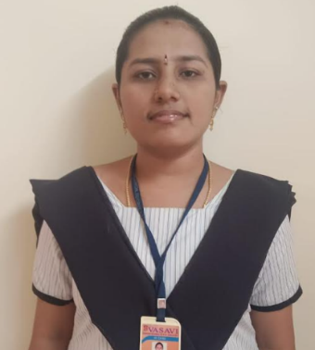



CRM Application For Jewel Management-[Admin]
Sri Vasavi Degree & Pg College
MENTOR NAME : SRI L.LAKSHMI NARAYANA
TEAM ID: LTVIP2025TMID19428
Team Leader: Bhagavatula Naga Sai Lakshmi Kamala
Email: kamalabhagavatula9@gmail.com
Team member: Gosala Lavanya
Email:Lavanyalucky2124@gmail.com
Team member: Sure Jyothi
Email: Jyothisure1905@gmail.com
Email:saisireeshabotta@gmail.com
Team member: Botta Sai Sireesha

Slide 2
Project Overview: Introduction to Salesforce: Overview of Salesforce and its key components -Understanding Salesforce editions and clouds- Exploring the Salesforce platform and its core services
Objectives:
➔ Configure Salesforce objects, fields, and relationships to support
business processes.
➔ Implement Organization-Wide Defaults (OWD) and Role-Based Access
Control to ensure data security.
➔ design and deploy page layouts, record types, and permission sets to
enhance user experience.
➔ Develop reports and dashboards to provide real-time insights and
support data-driven decision-making.

Slide 3
.➔ Implement Chatter Groups for enhanced collaboration and
communication.
➔ Conduct user training and adoption programs to ensure seamless
transition to the new system.
Salesforce key features and concepts utilized :
Salesforce
Object
Tabs
The Lightning App
Fields
Profiles
Roles
Users
Page Layouts
Record Types
Permission Sets
User Adoption
Reports
Creating Dashboards
Flow

Slide 4
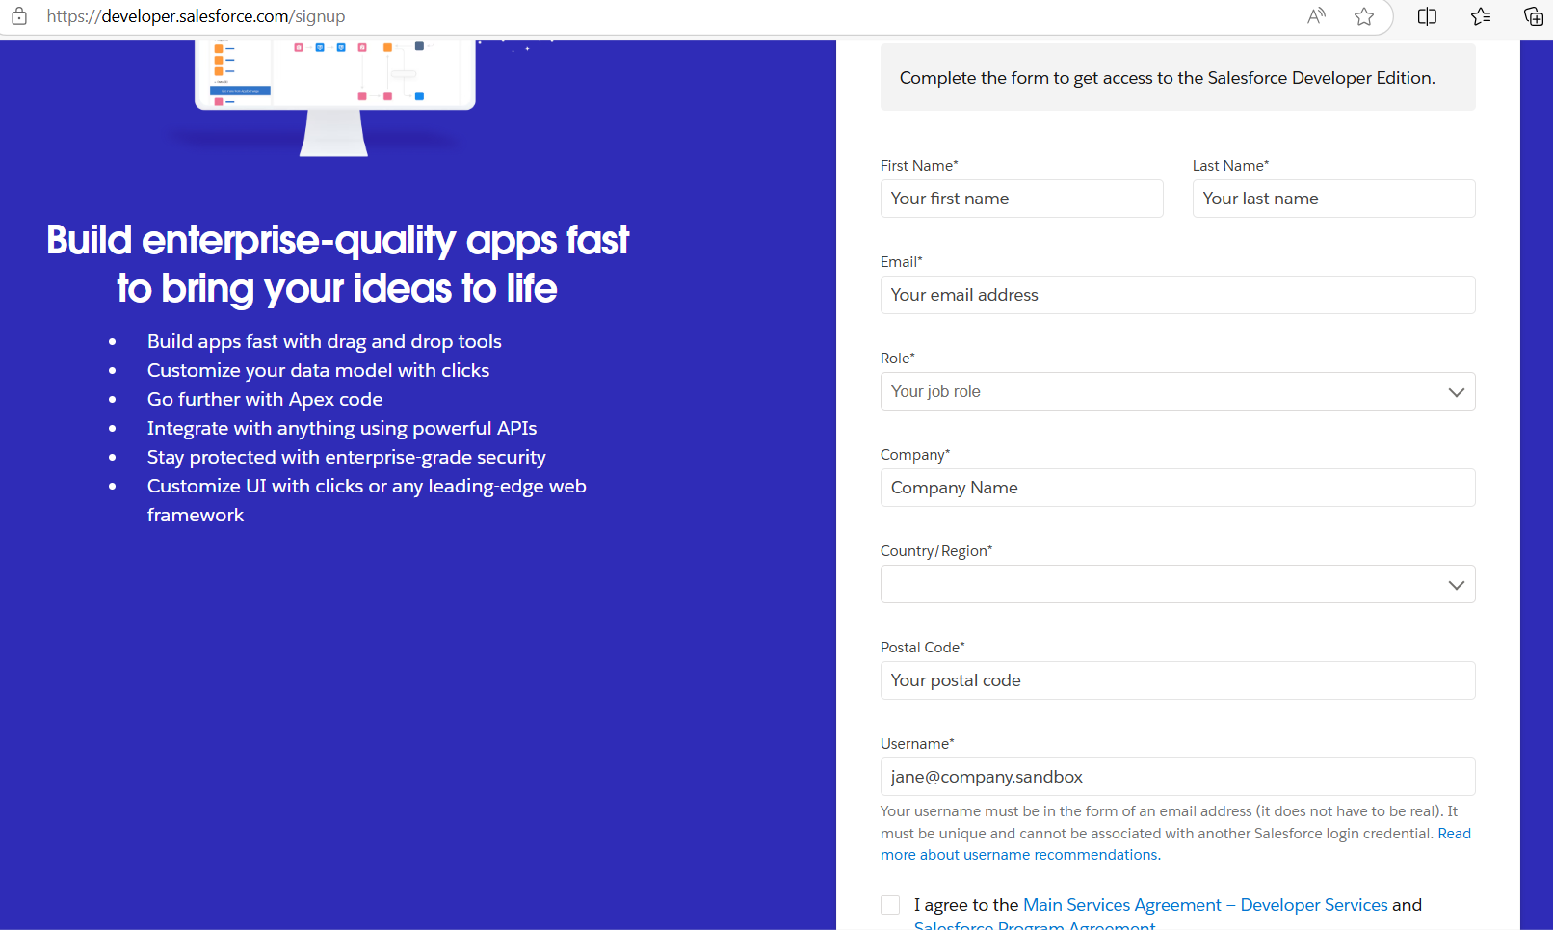
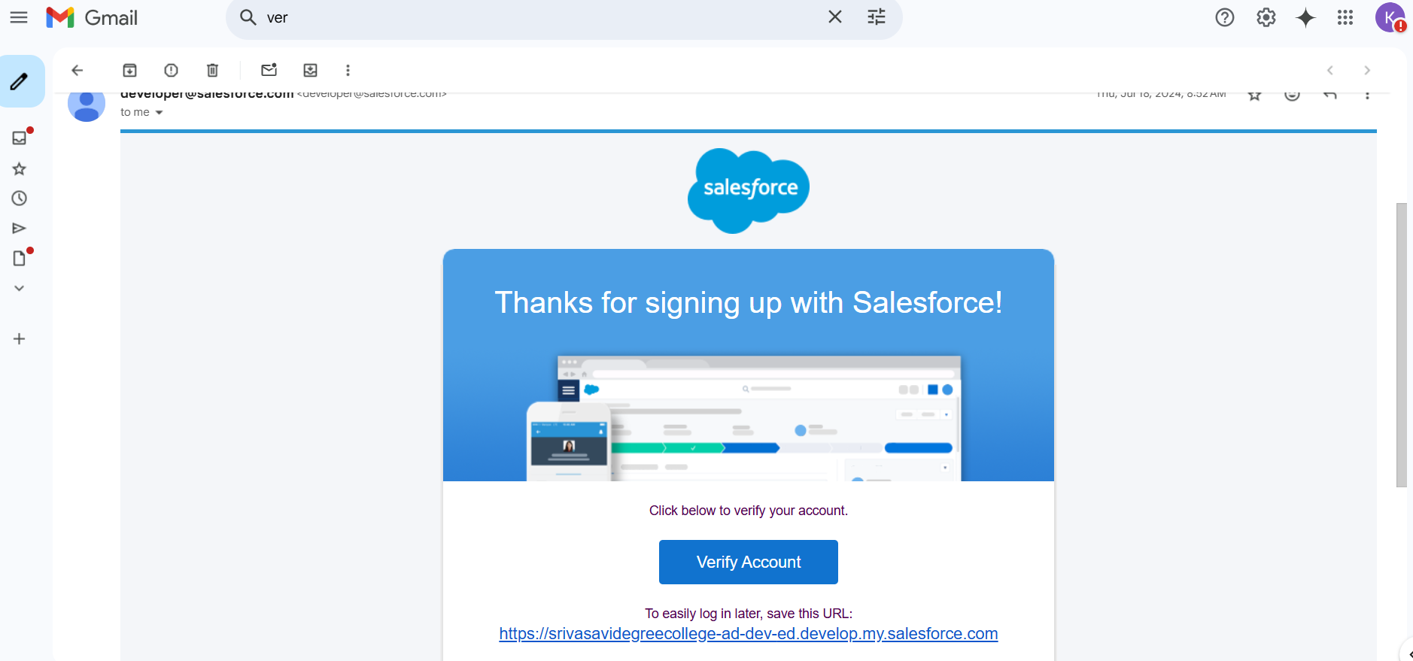
Detailed steps to solution design : Salesforce: Creating Developer Account:
Creating Developer Account:
Account Activation: Account Activation:
Account Activation:

Slide 5
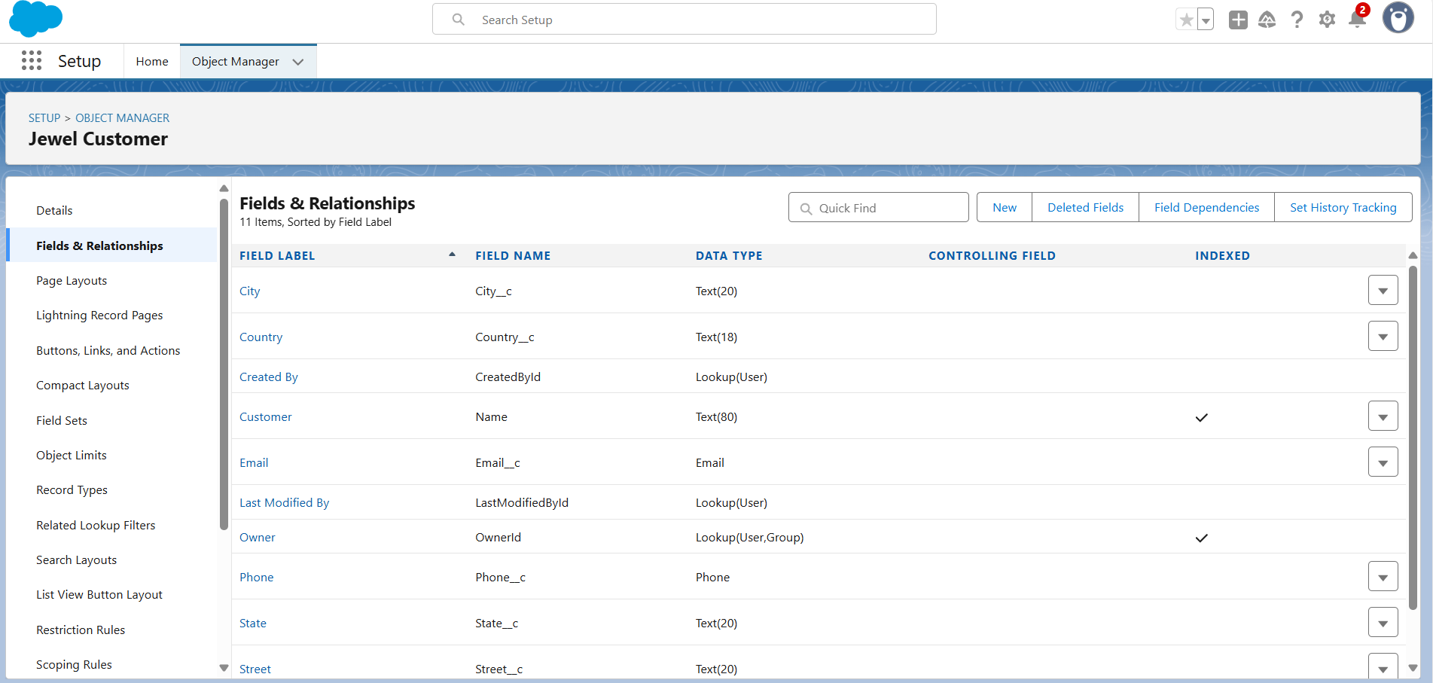
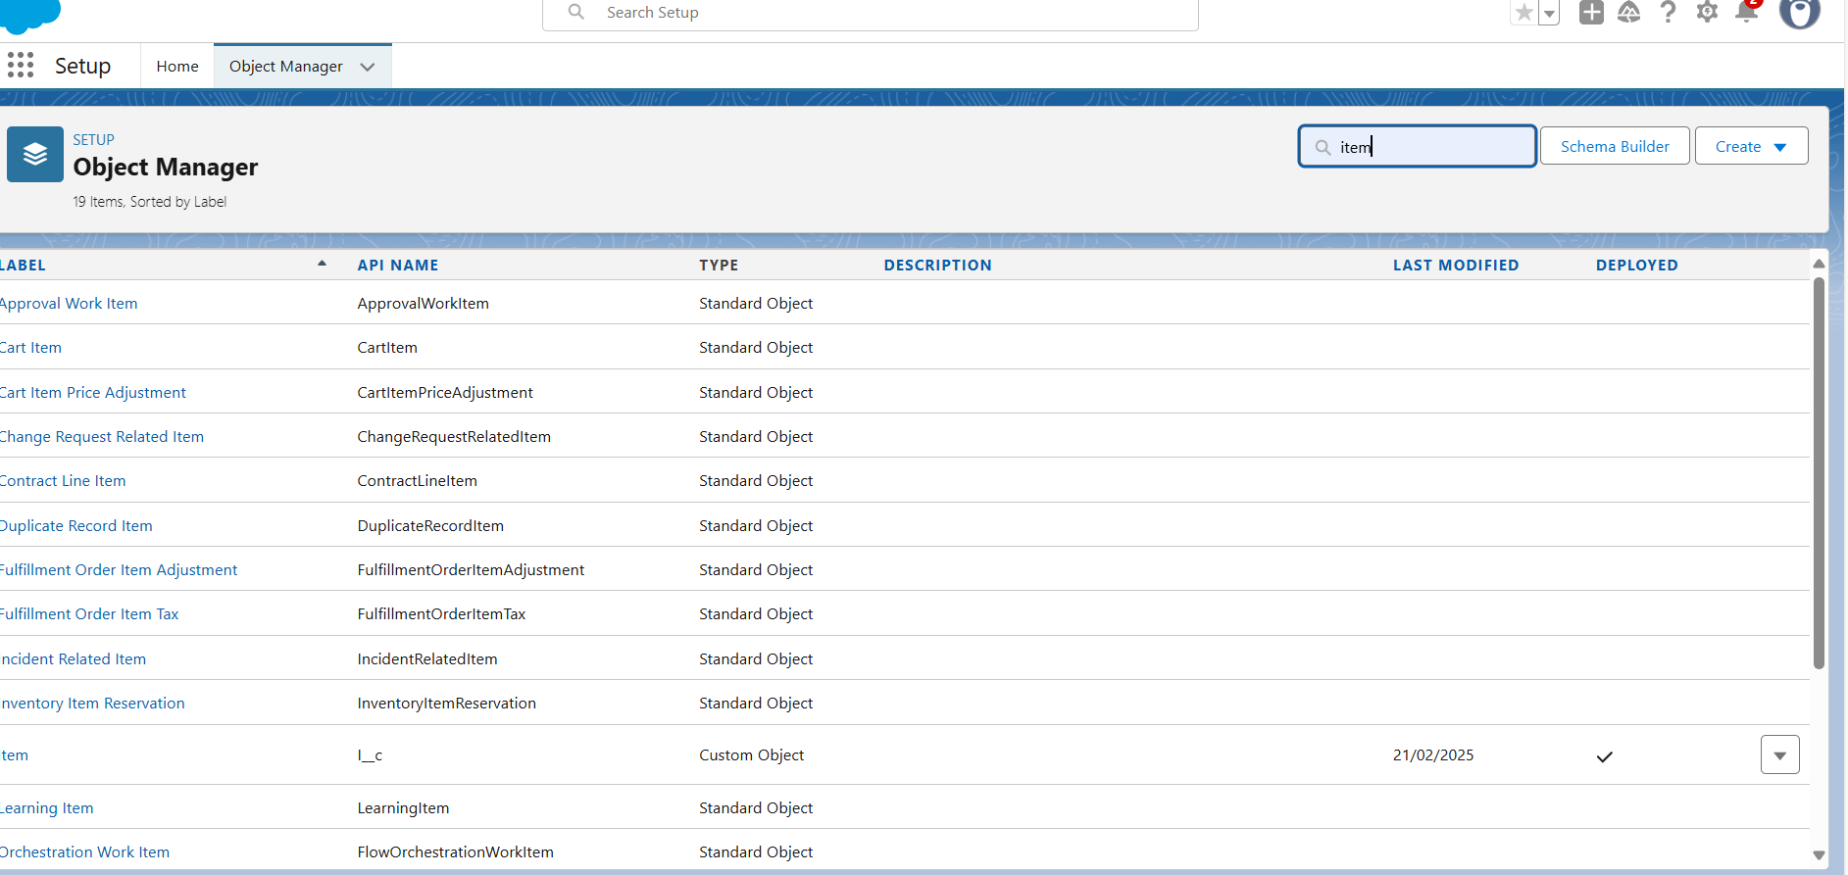
Object: Create Jewel Customer Object:
Create Item Object :

Slide 6
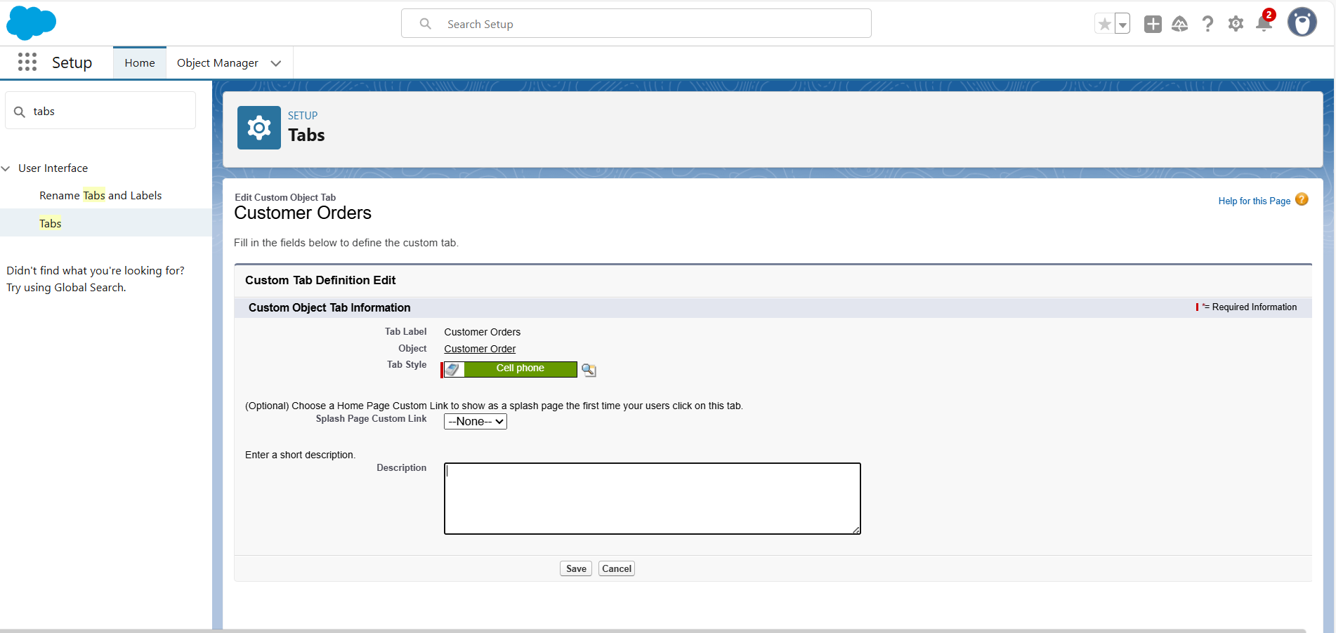
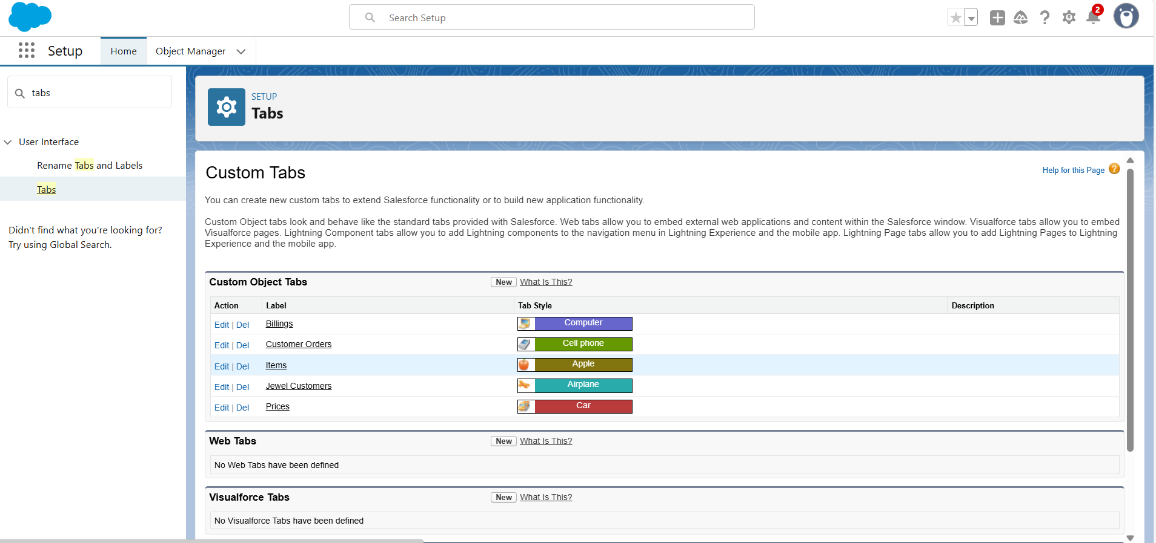
Tabs: Creating a Custom Tab:
To create a Tab:(Item)

Slide 7
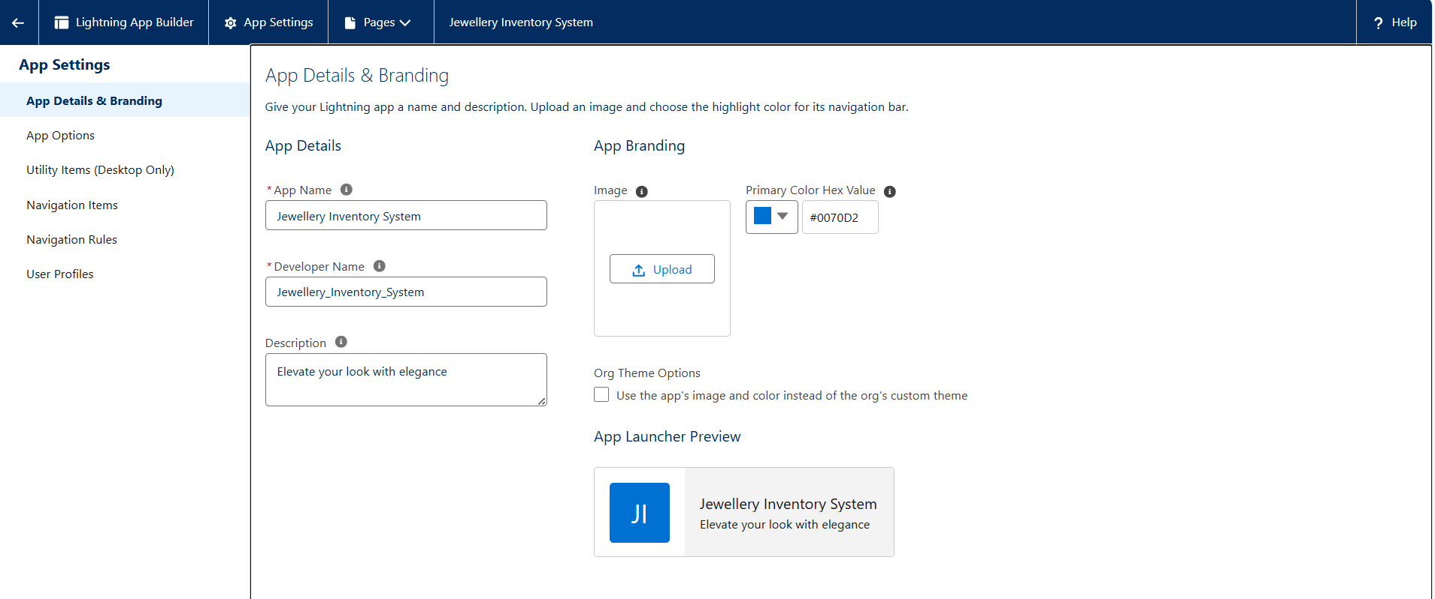
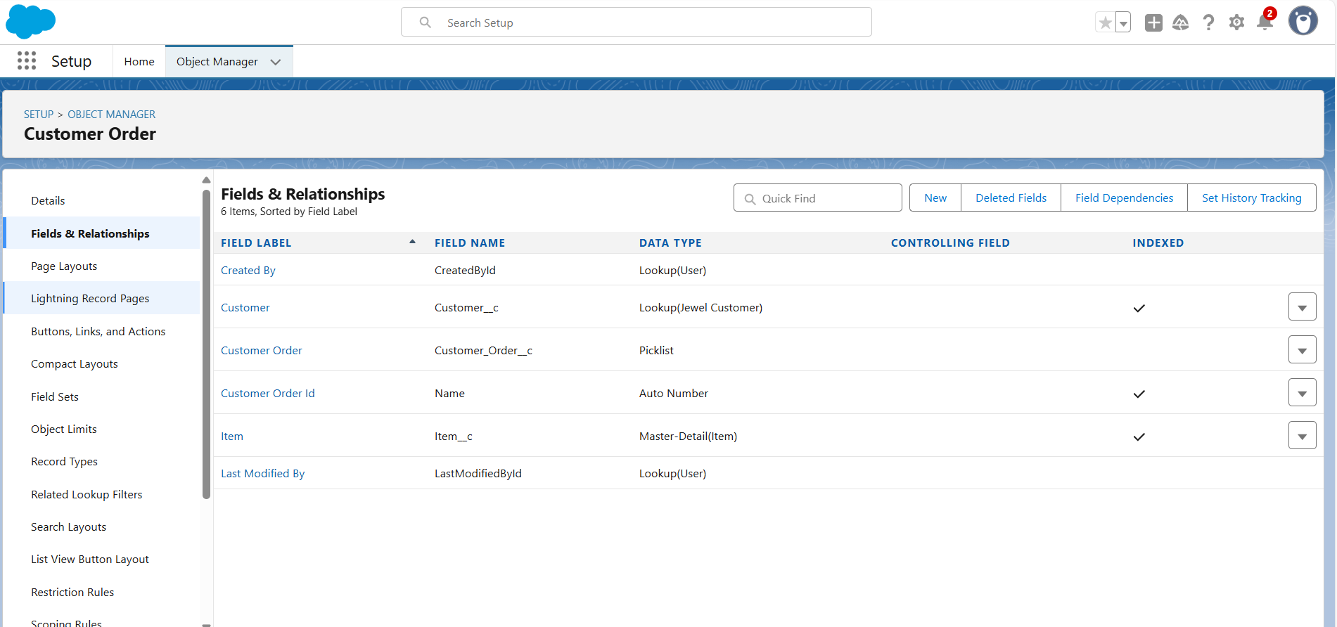
The Lightning App: Create A Lightning App:
Fields:
Creating Lookup Relationship:

Slide 8
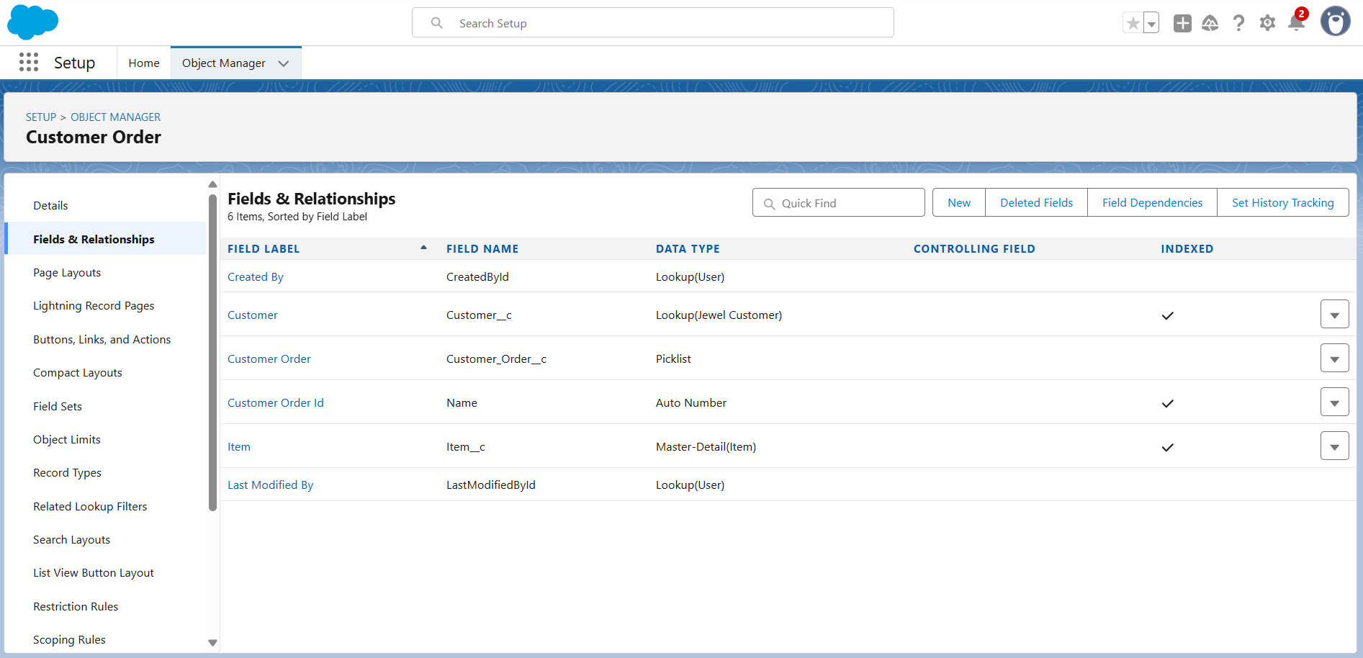
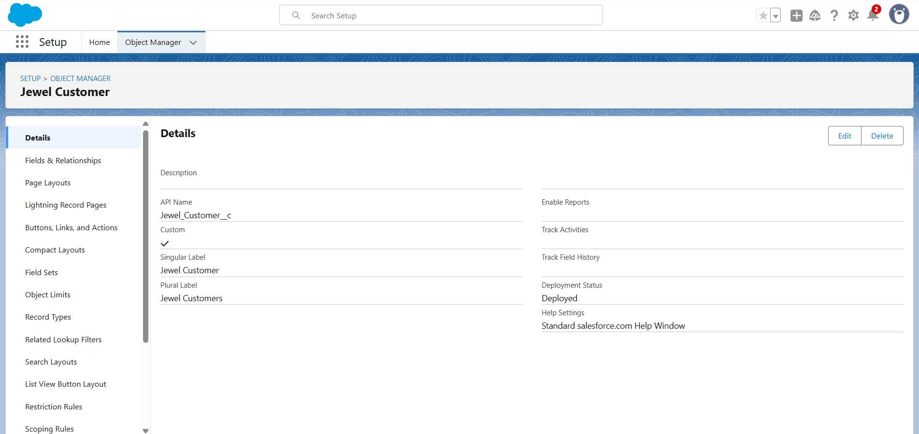
Creating a Master-Detail Relationship:
Creating Text Field in Jewel Customer Object:
Creating Text Field in Jewel Customer Object:
Create A Lightning App:

Slide 9
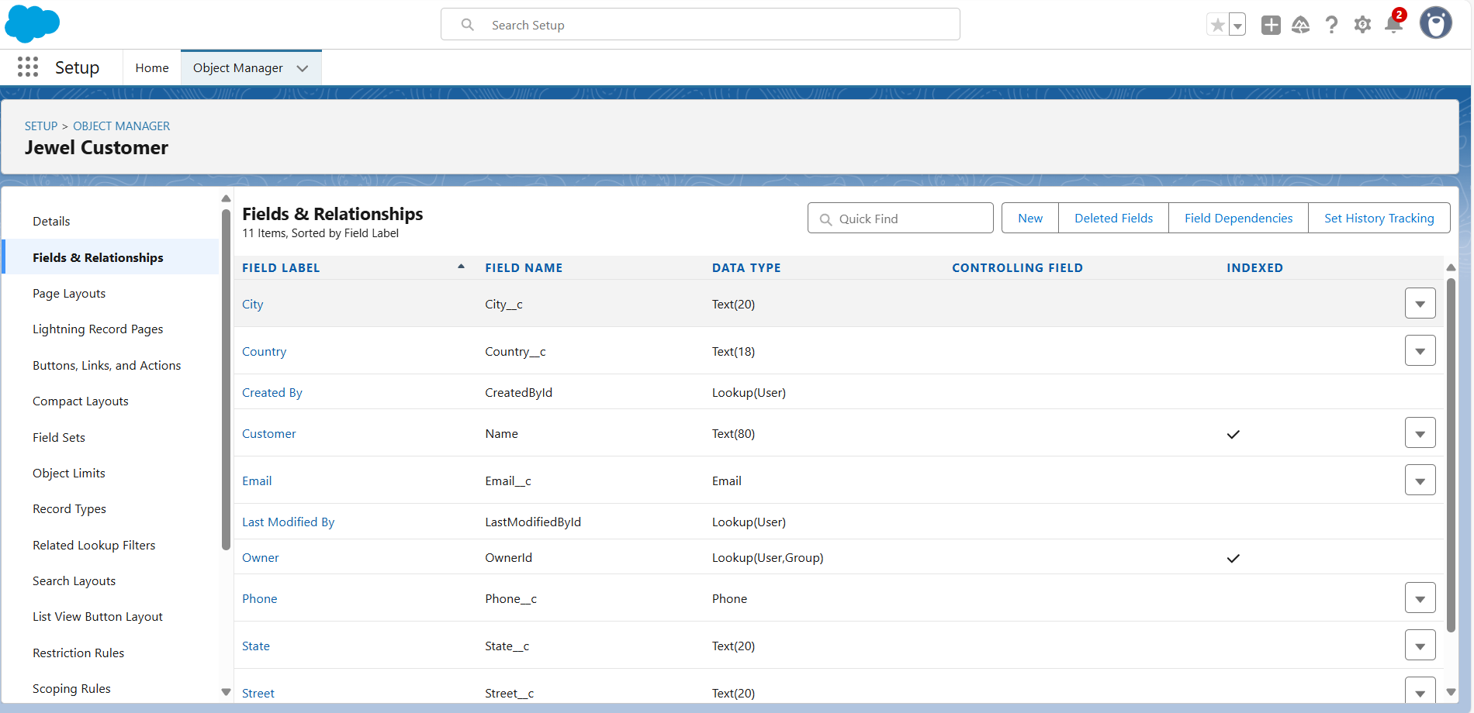
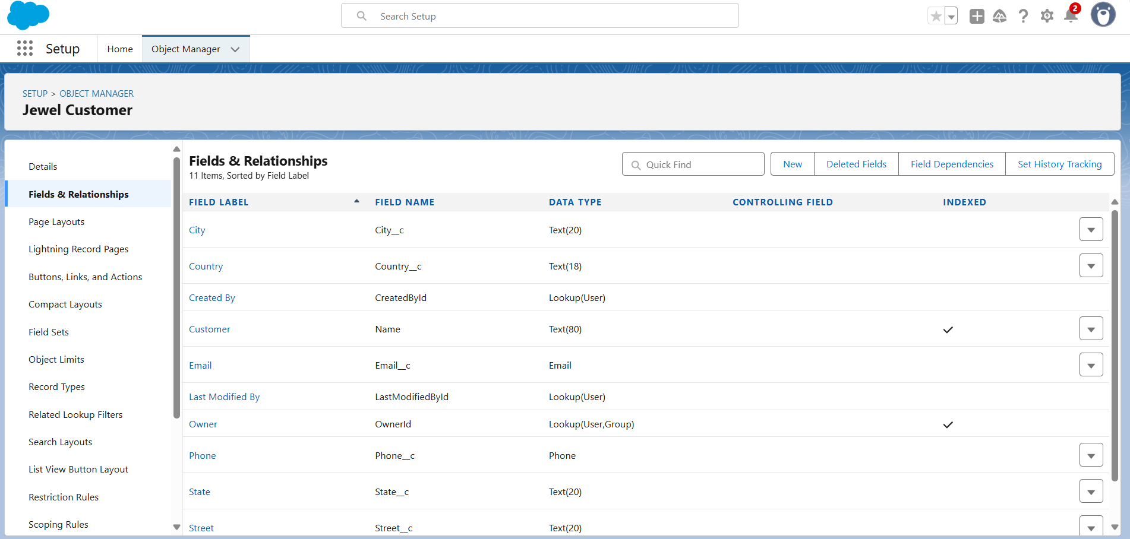
Creating The Phone Field In Object Jewel Customer:
Creating The Email Field In Object Jewel Customer:

Slide 10
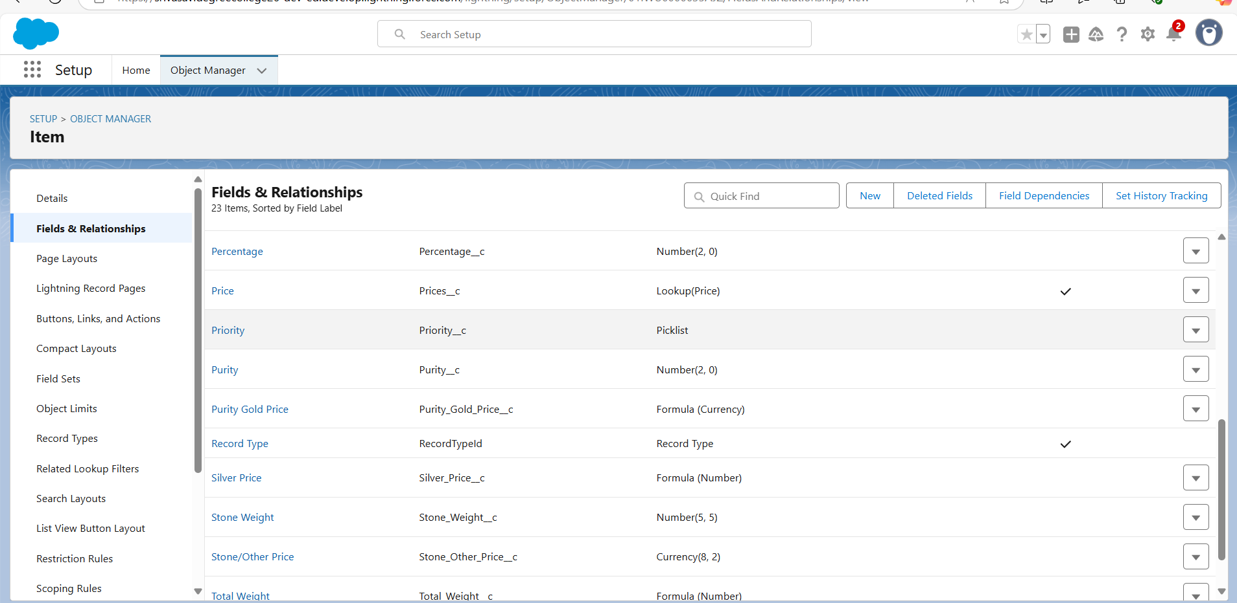
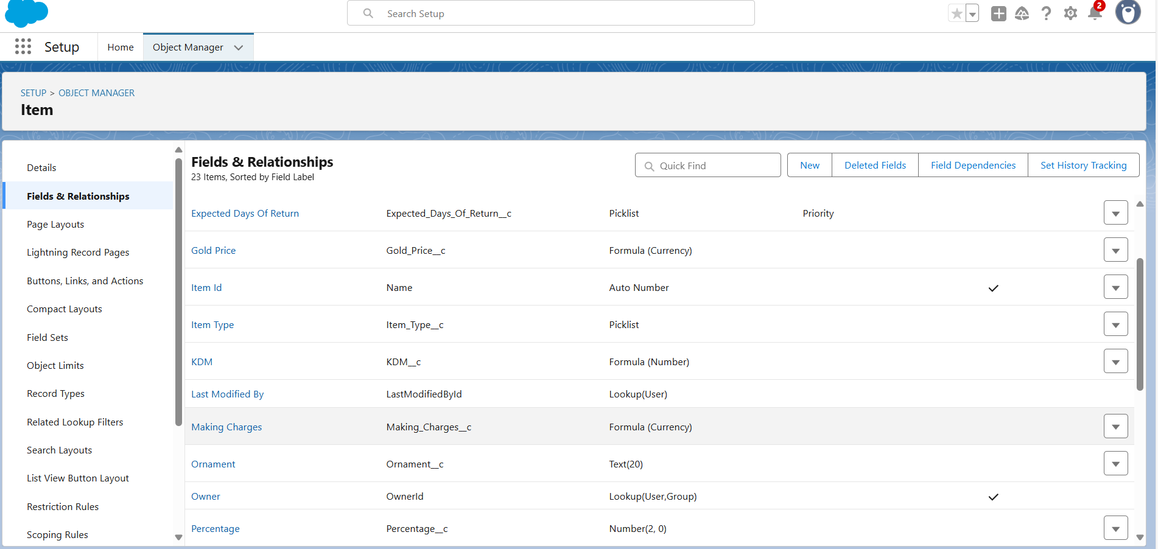
Creating The Number Field in Item Object:
Creating Picklist Field In Item Object:
Creating Picklist Field In Item Object:

Slide 11
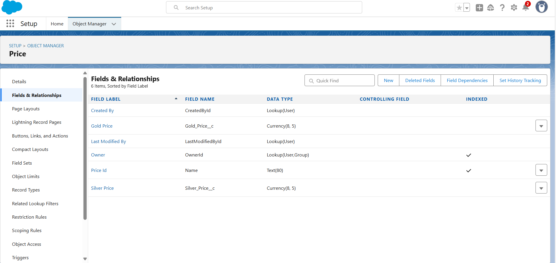
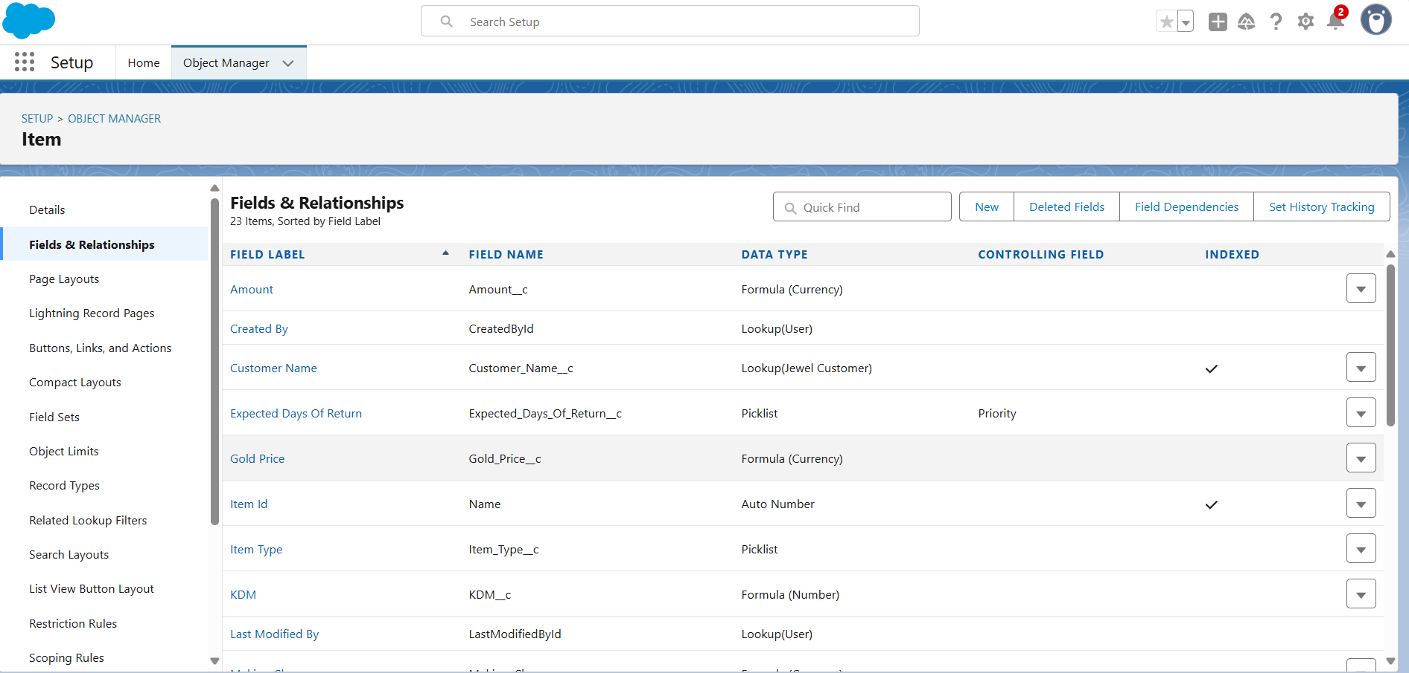
Creating Picklist Field In Item Object:
Creating Formula Field (Cross Object) In Item Object:

Slide 12
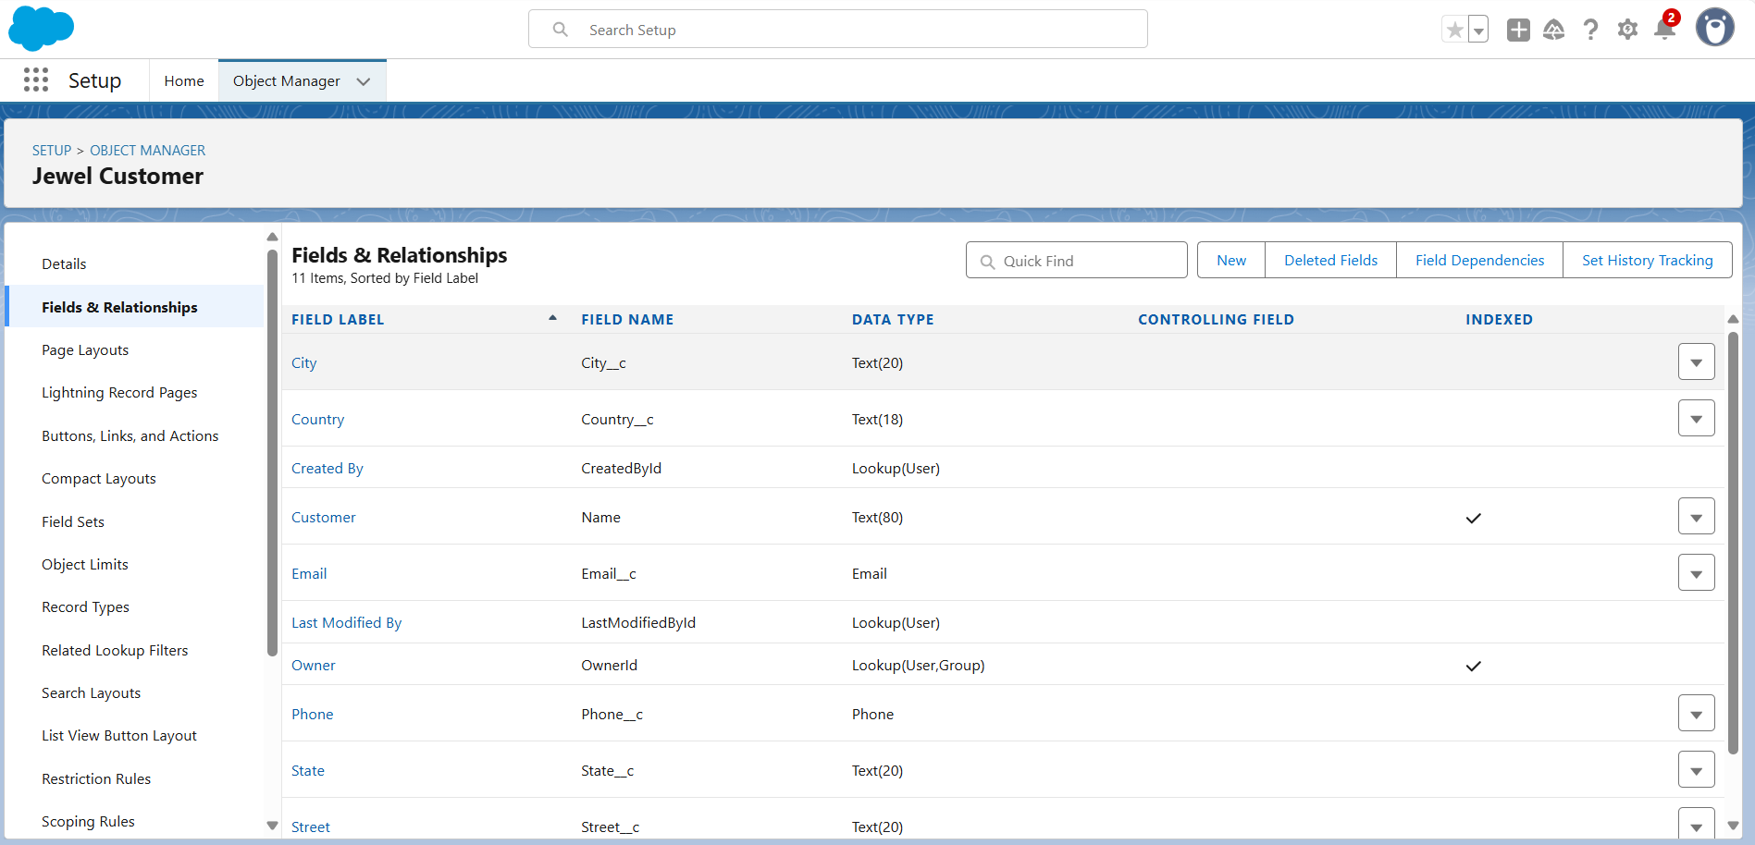
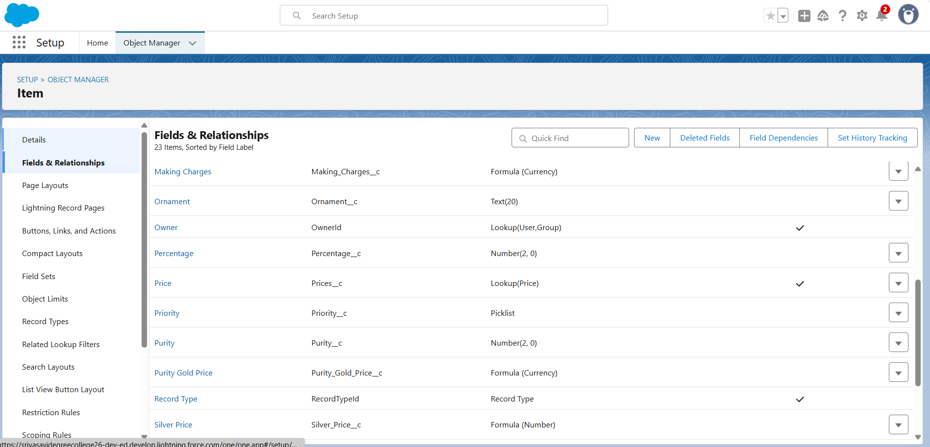
Creating Remaining Fields In Objects: Jewel Customer:
Price:
::

Slide 13
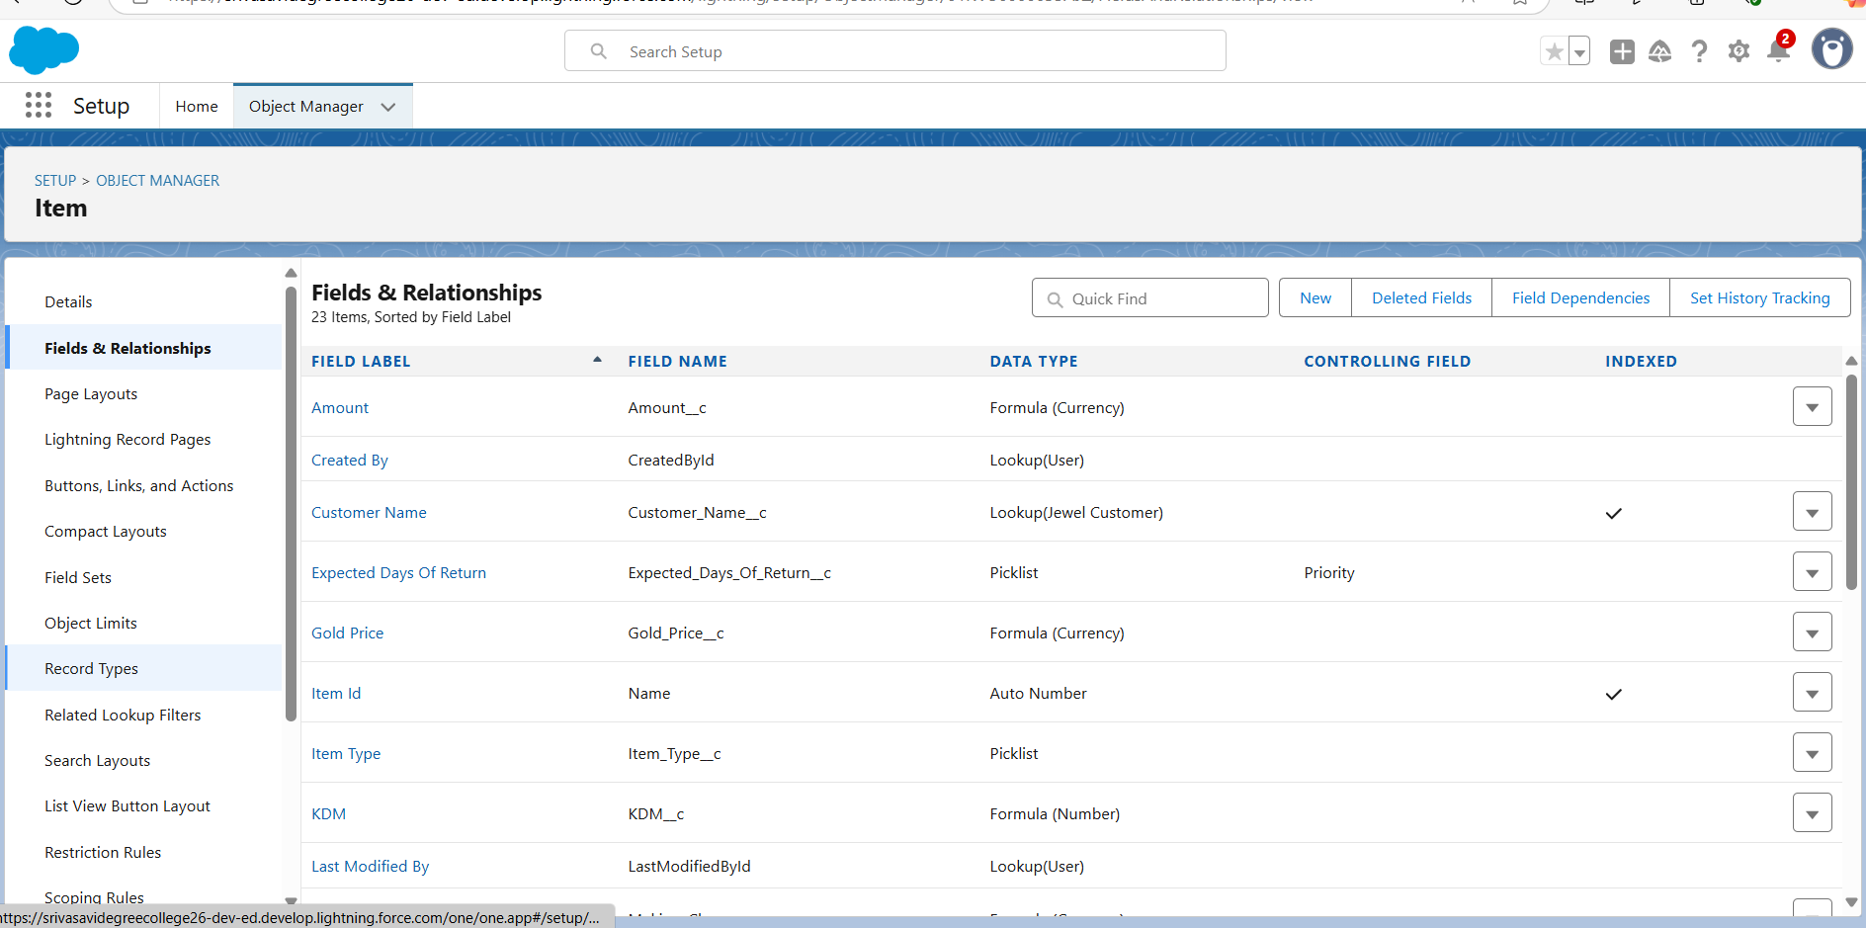
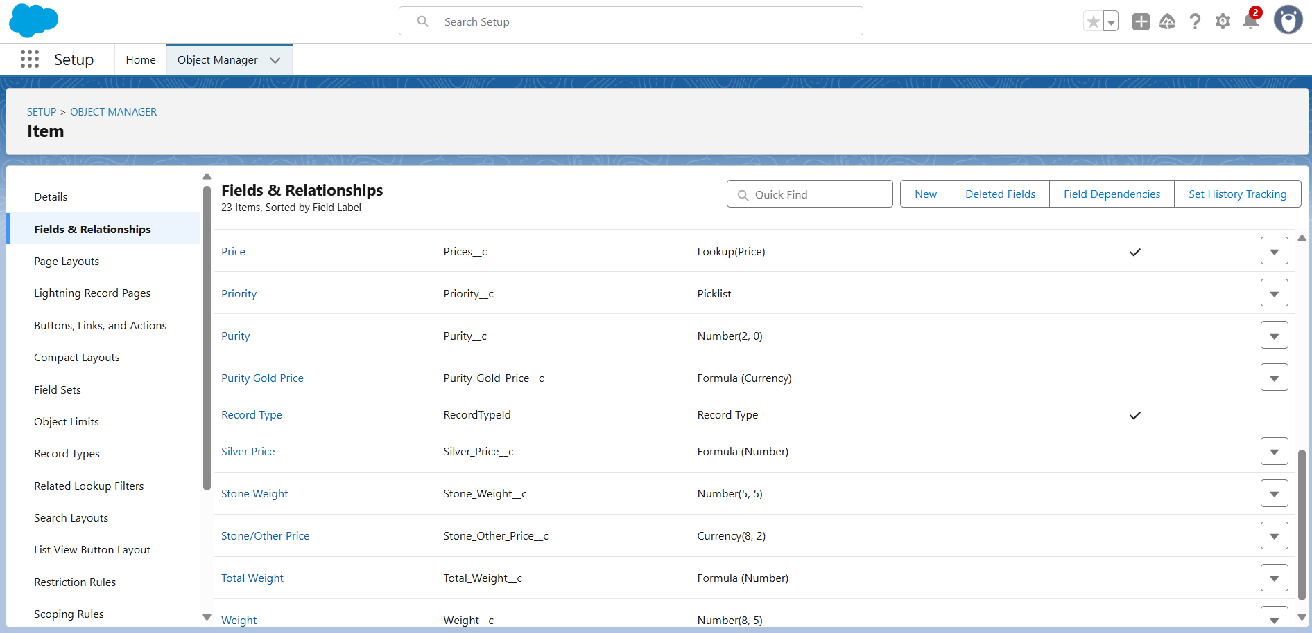
Item:

Slide 14
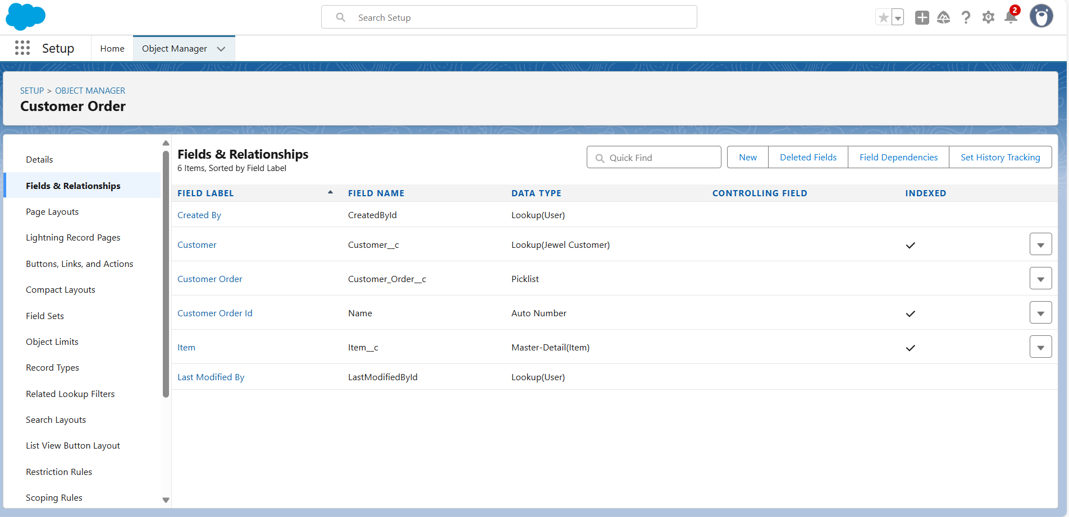
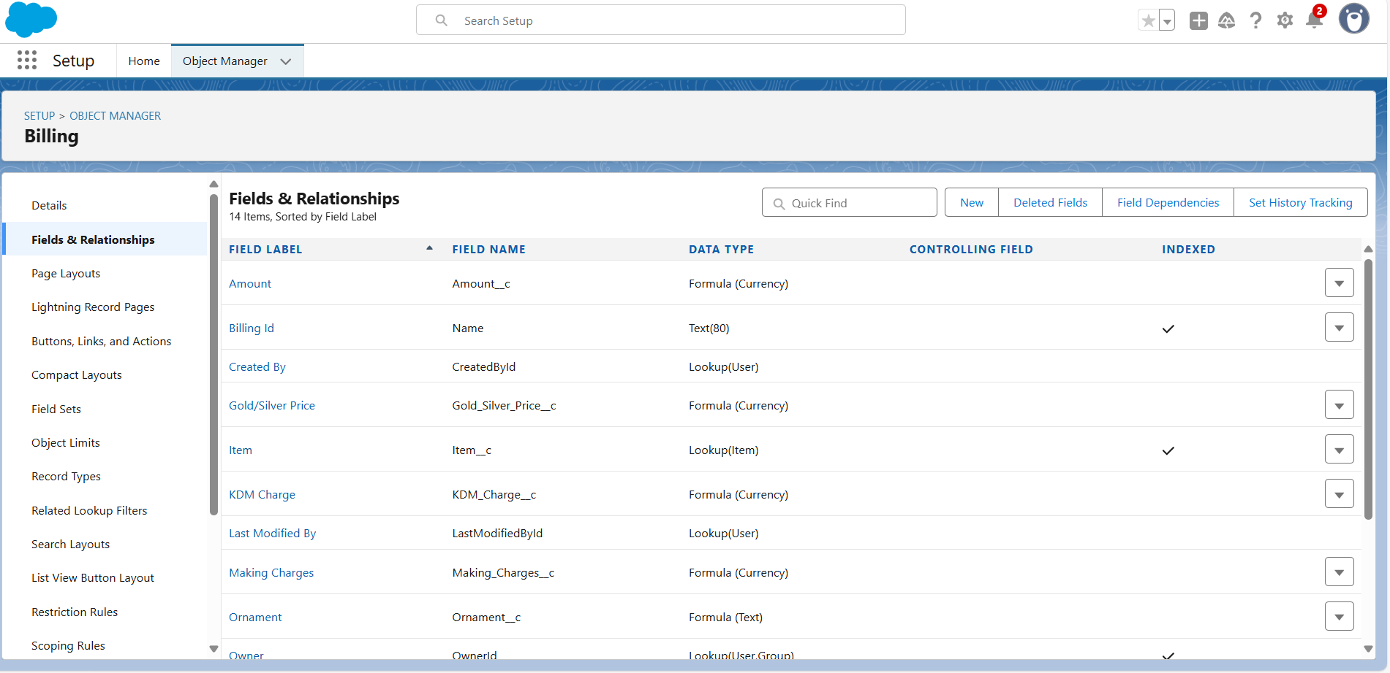
Customer Order:
Billing:

Slide 15
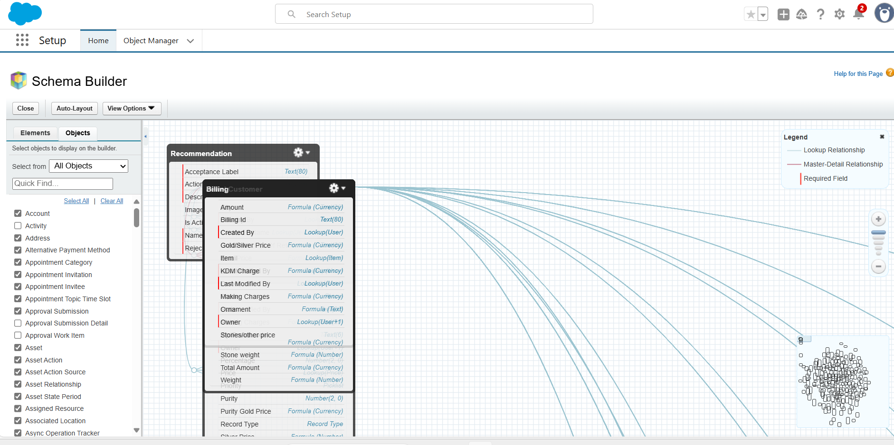
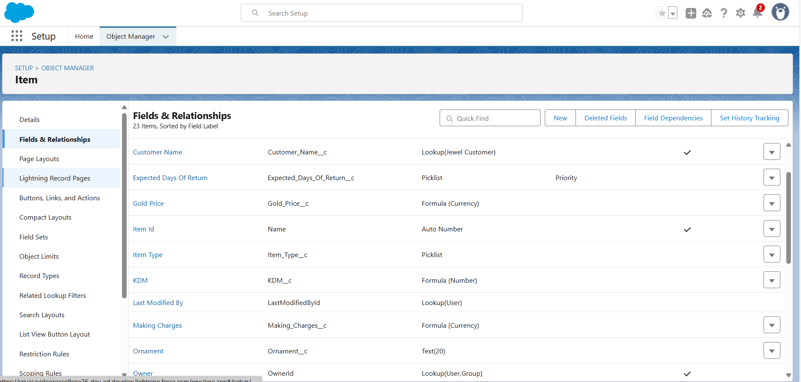
Schema Builder:
Creating The Field Dependencies:

Slide 16
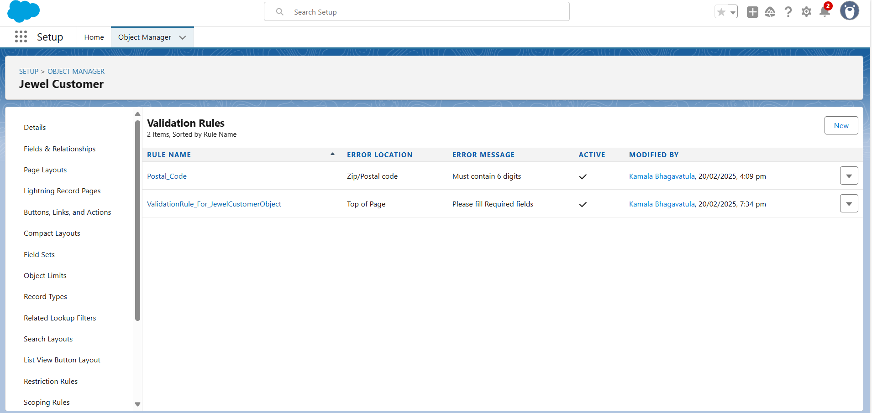
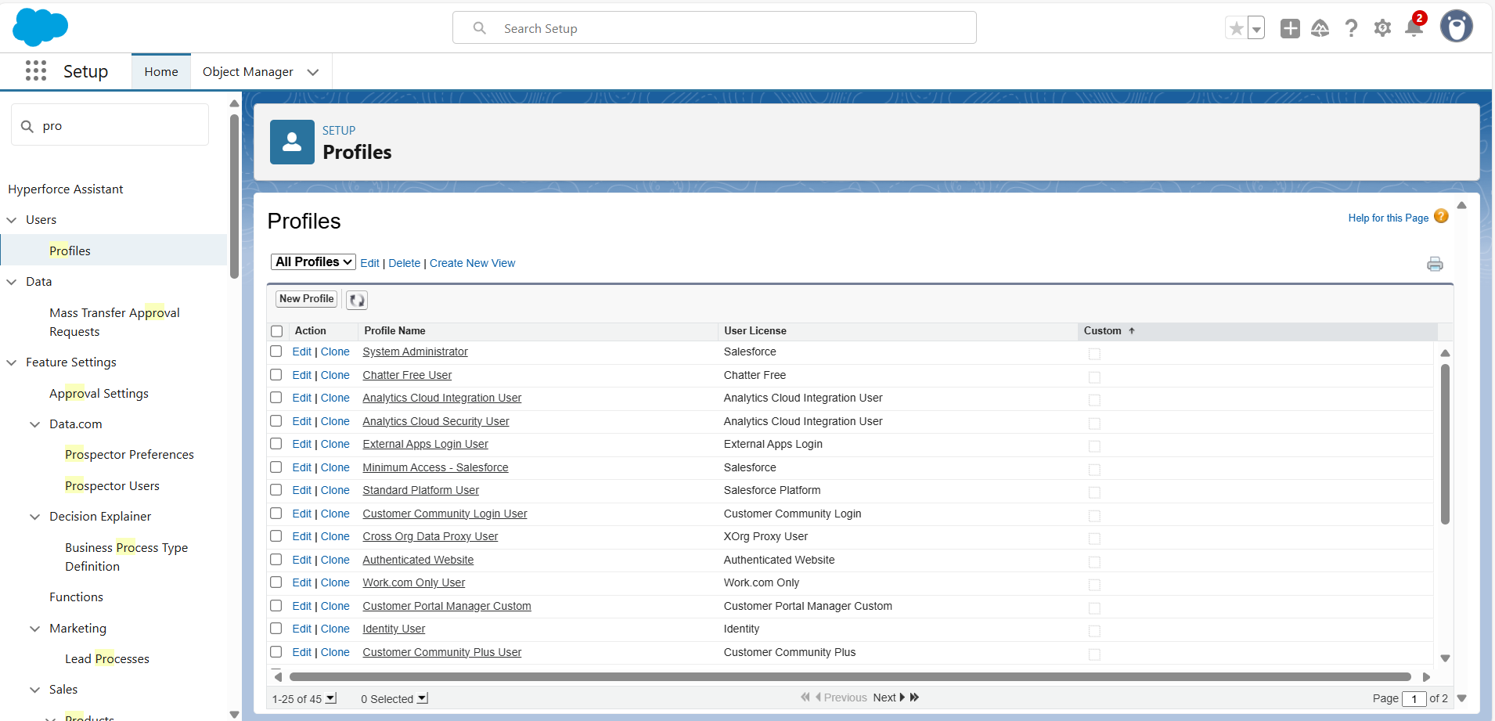
Creating the validation rule:
Profiles:
Gold Smith Profile:

Slide 17
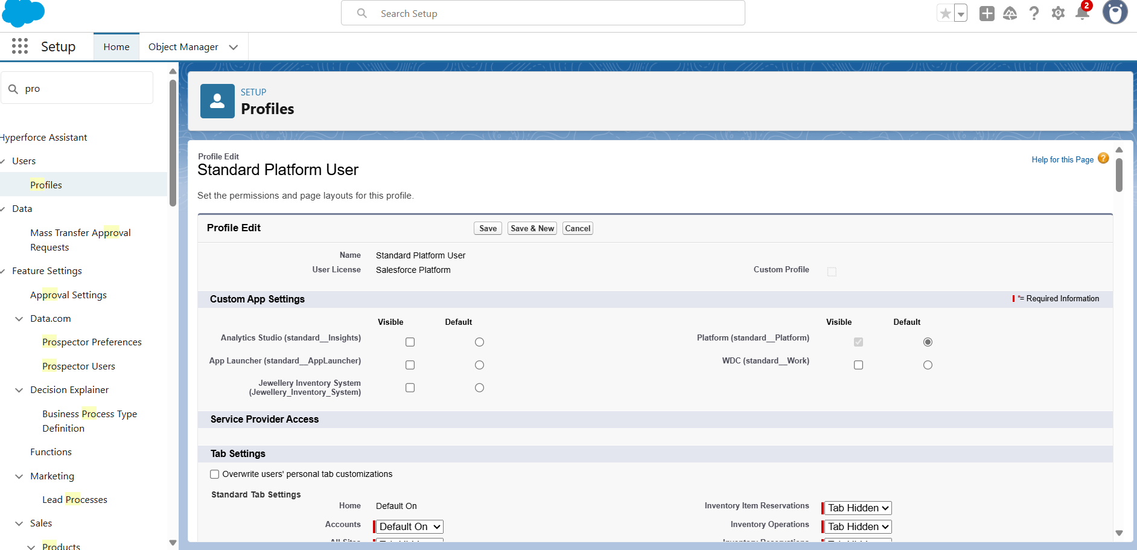
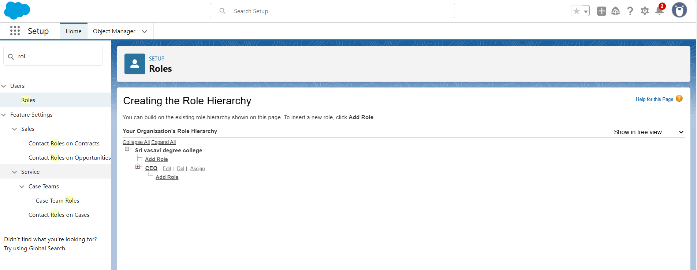
Worker Profile:
Roles:
Creating Gold Price Profile:

Slide 18
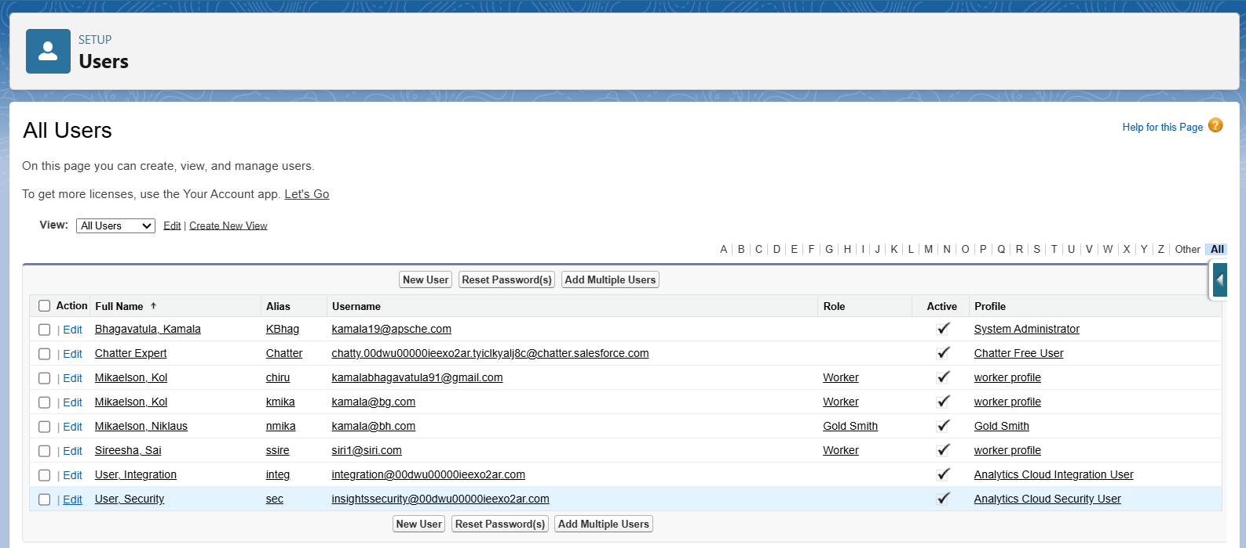
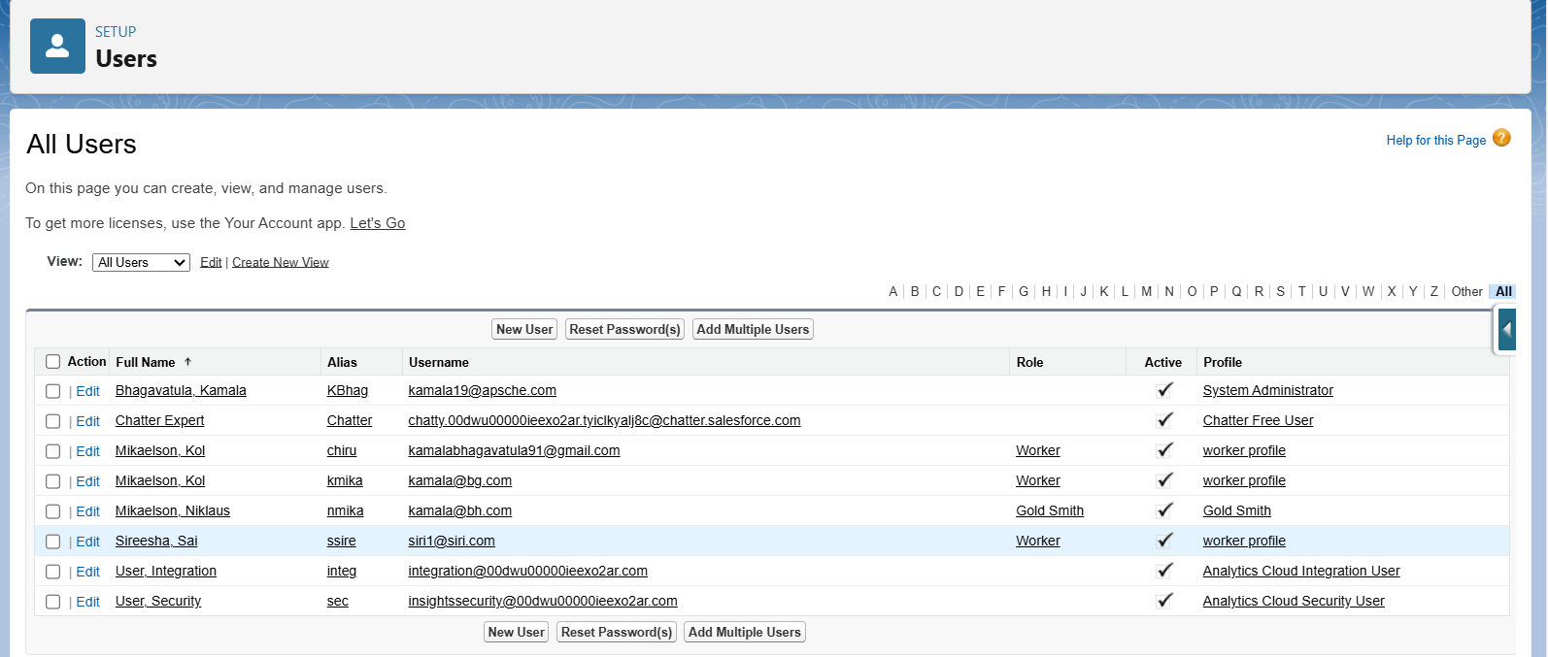
Users: Create User:
Create User:

Slide 19
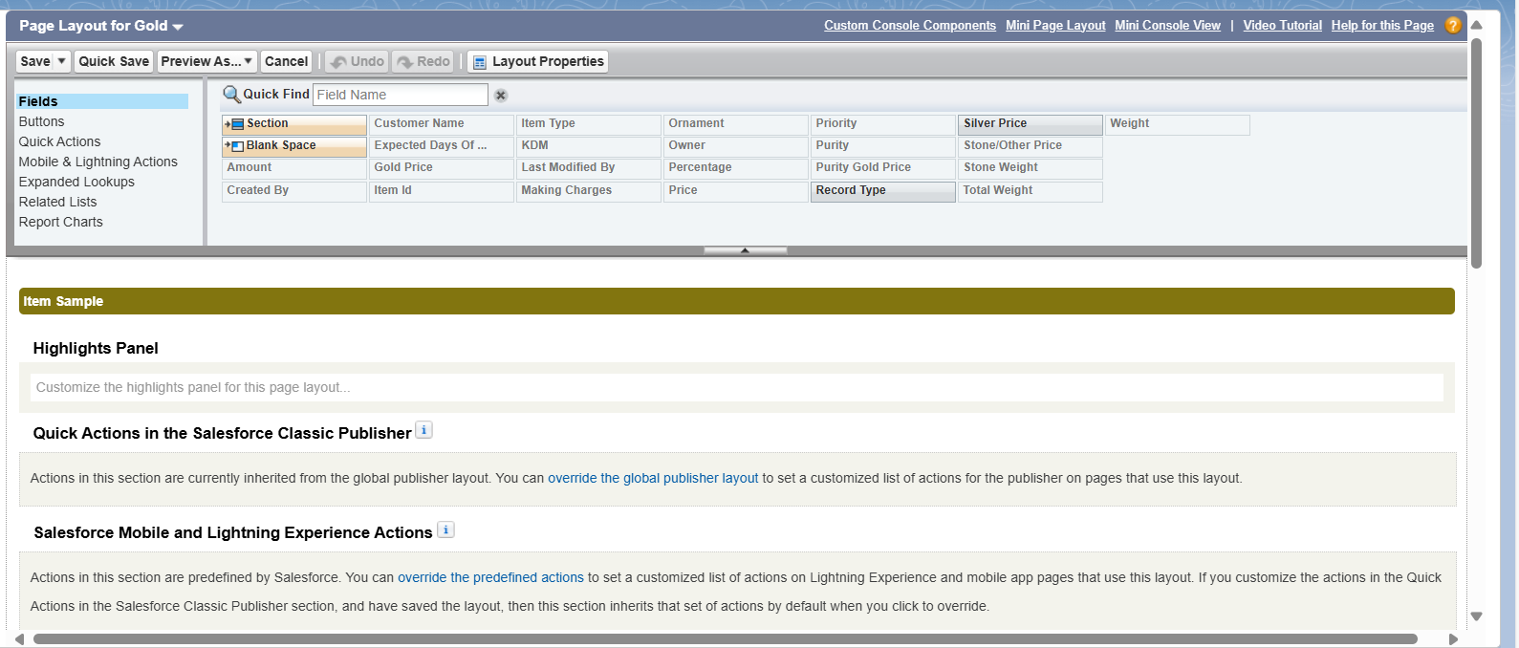
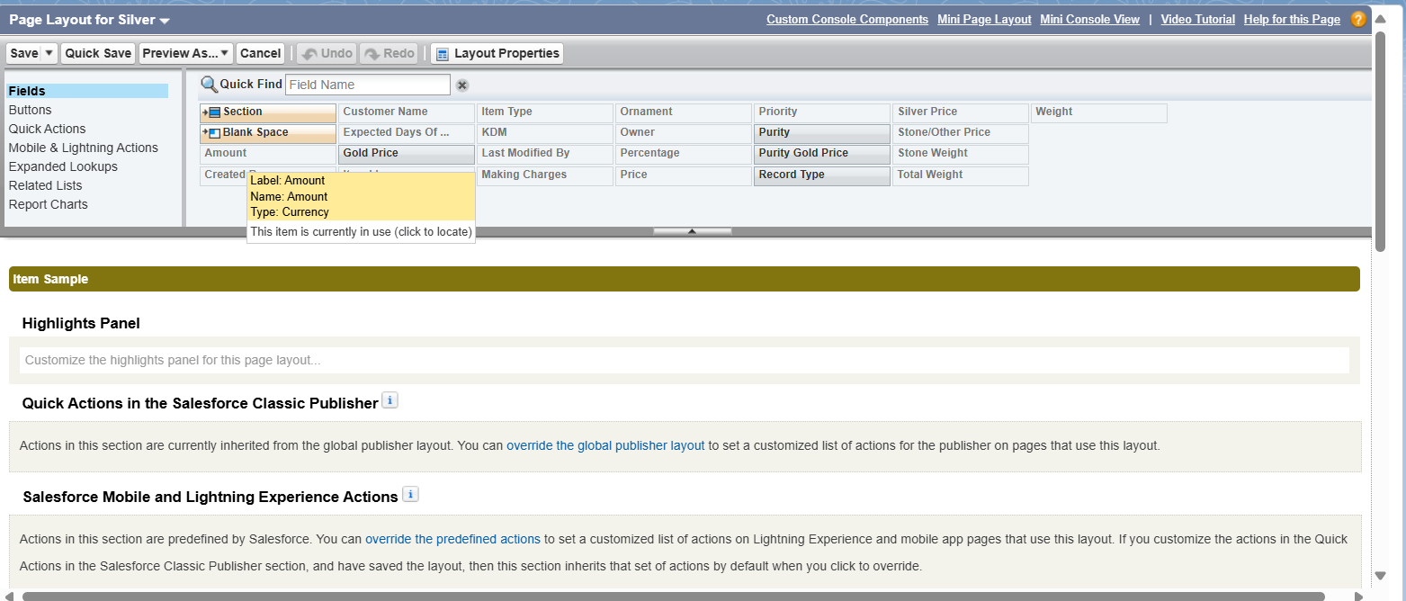
Page Layouts: To Create A Gold Page Layout:
To Create A Silver Page Layout:
To Create A Silver Page Layout:

Slide 20
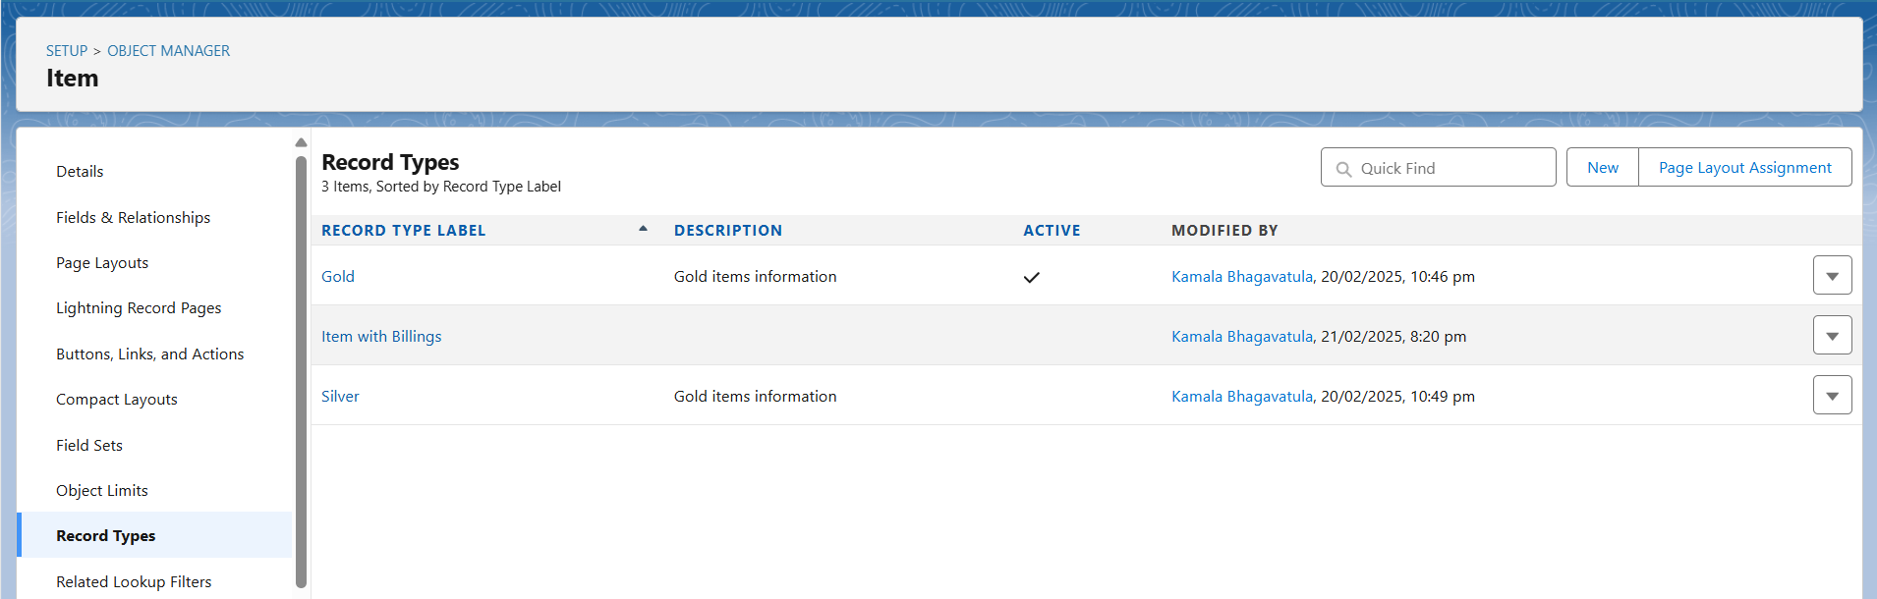
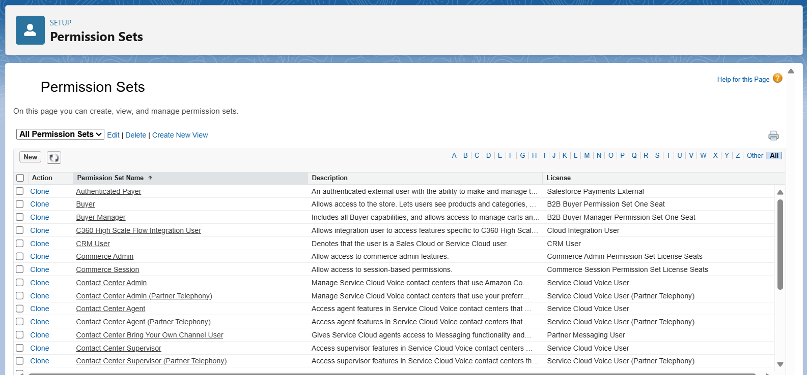
Record Types: To Create A Record Type:
Permission Sets:
Creating Permission Set:

Slide 21
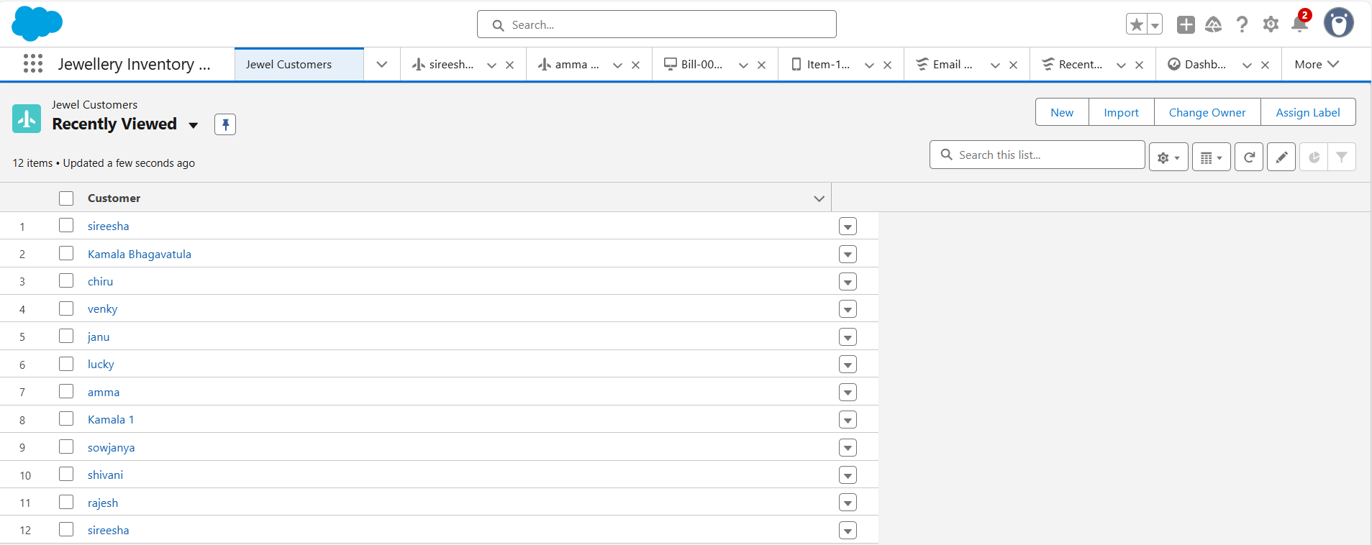
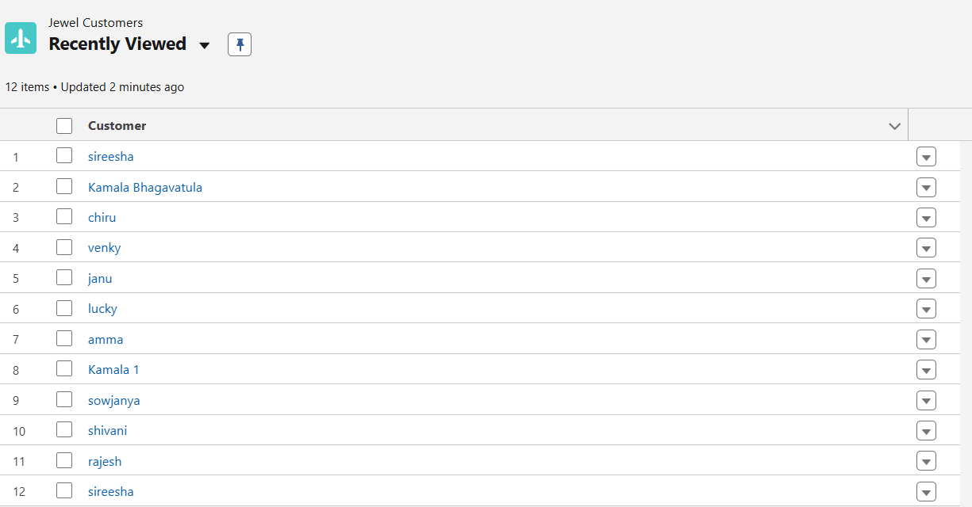
User Adoption:
Create A Record (Jewel Customer):
View A Record (Jewel Customer):
View A Record (Jewel Customer):

Slide 22
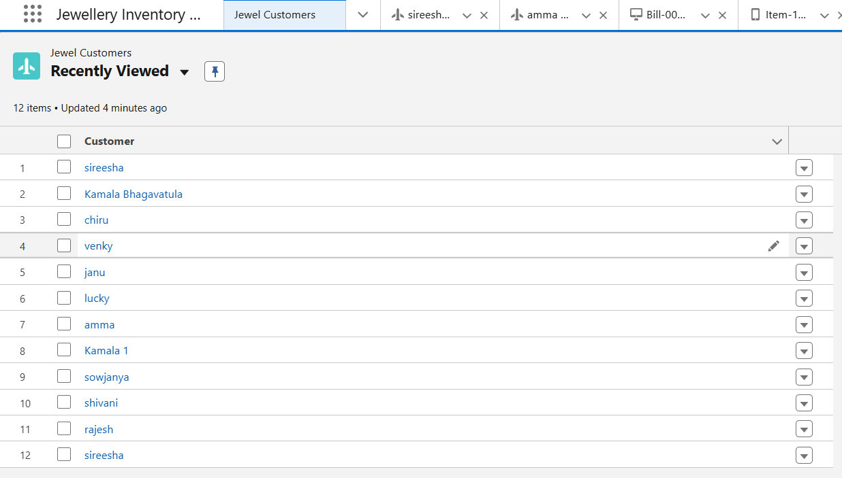
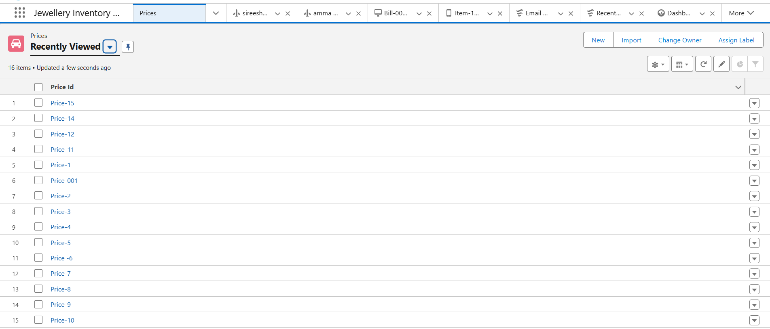
Delete A Record (Jewel Customer):
Jewel Customer:
Price:

Slide 23
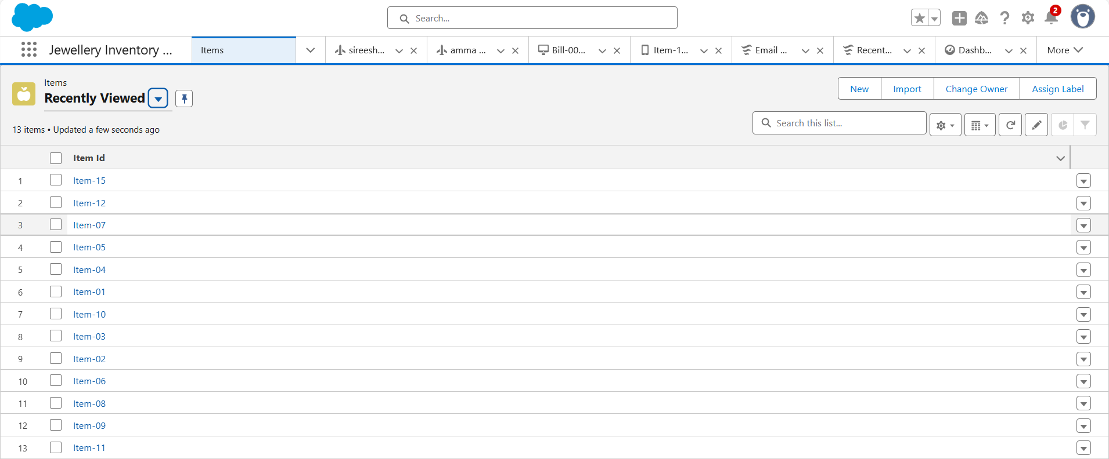
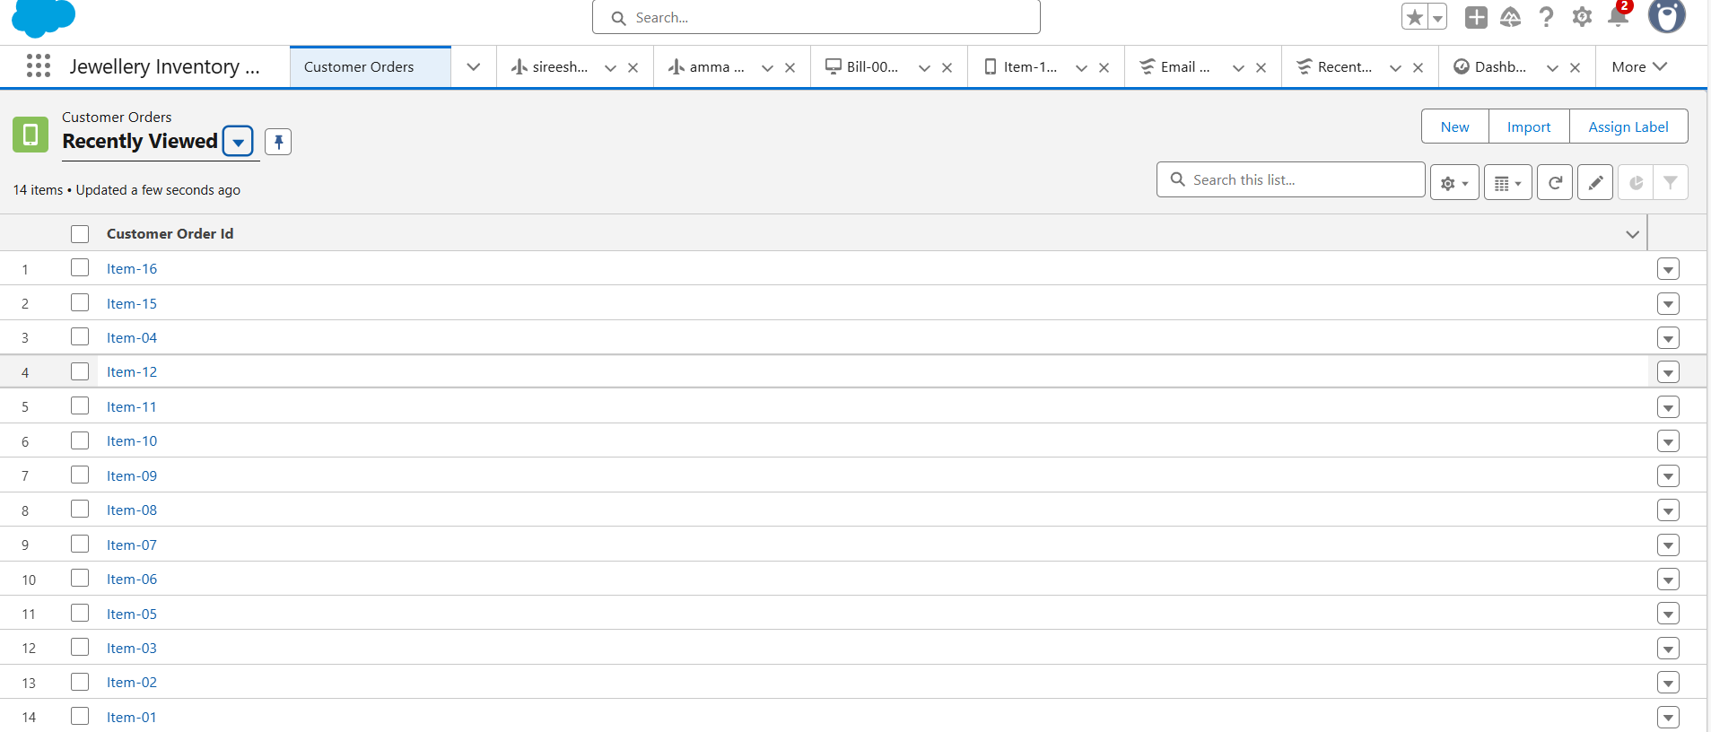
Item:
Customer Orders:

Slide 24
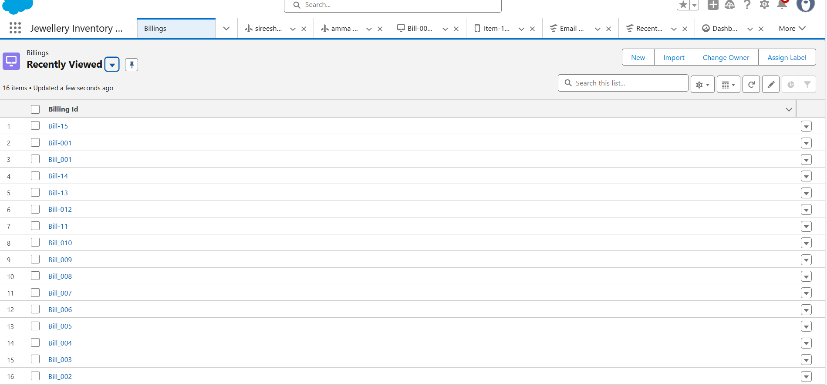
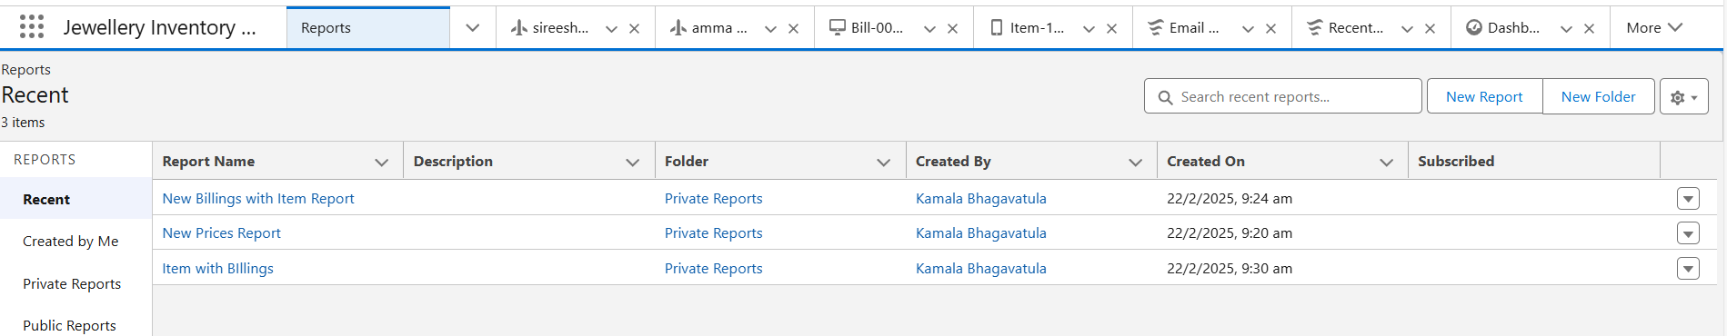
Billing:
Reports:
Create Report:

Slide 25
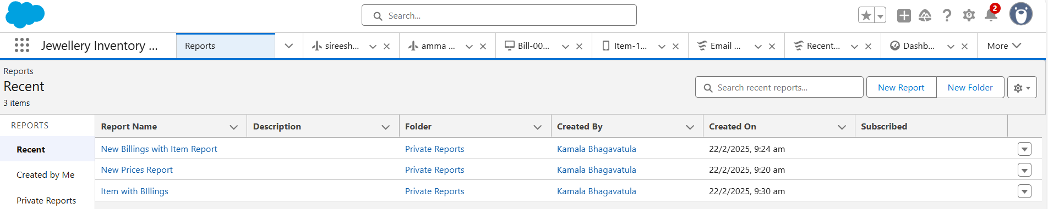
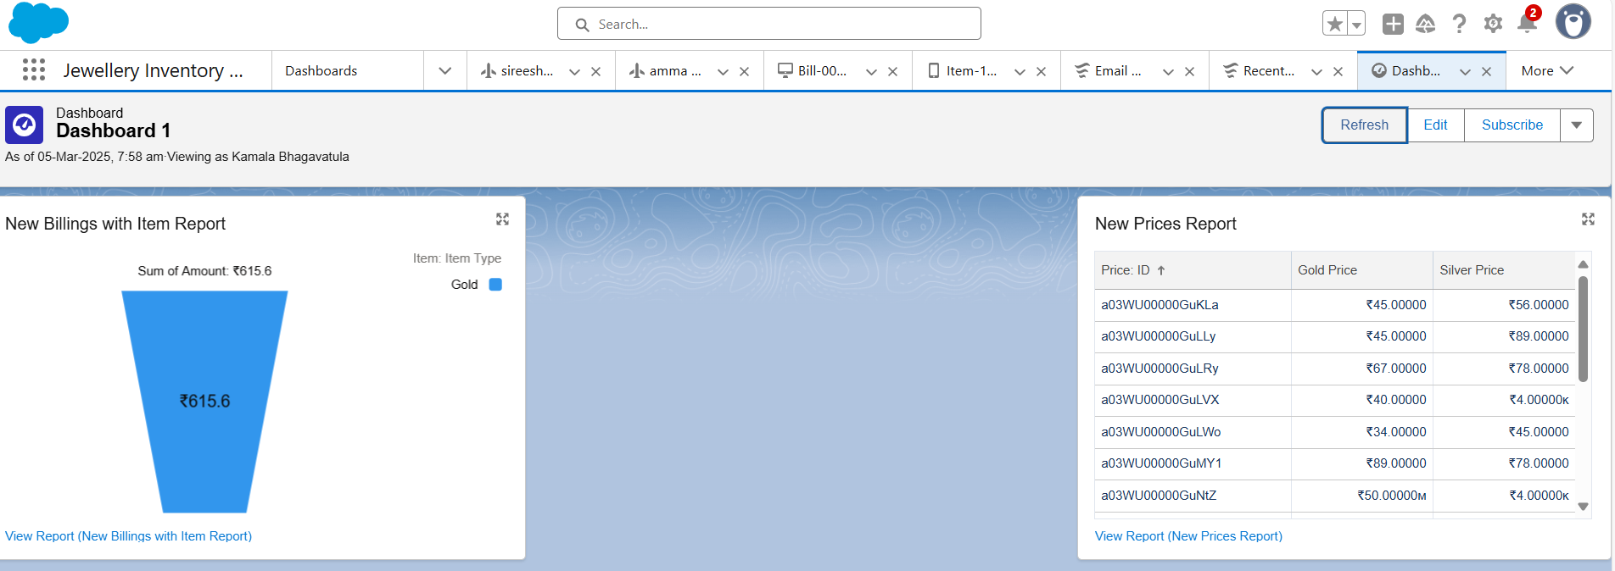
Creating Report:
Dashboards:
Creating Dashboards:

Slide 26
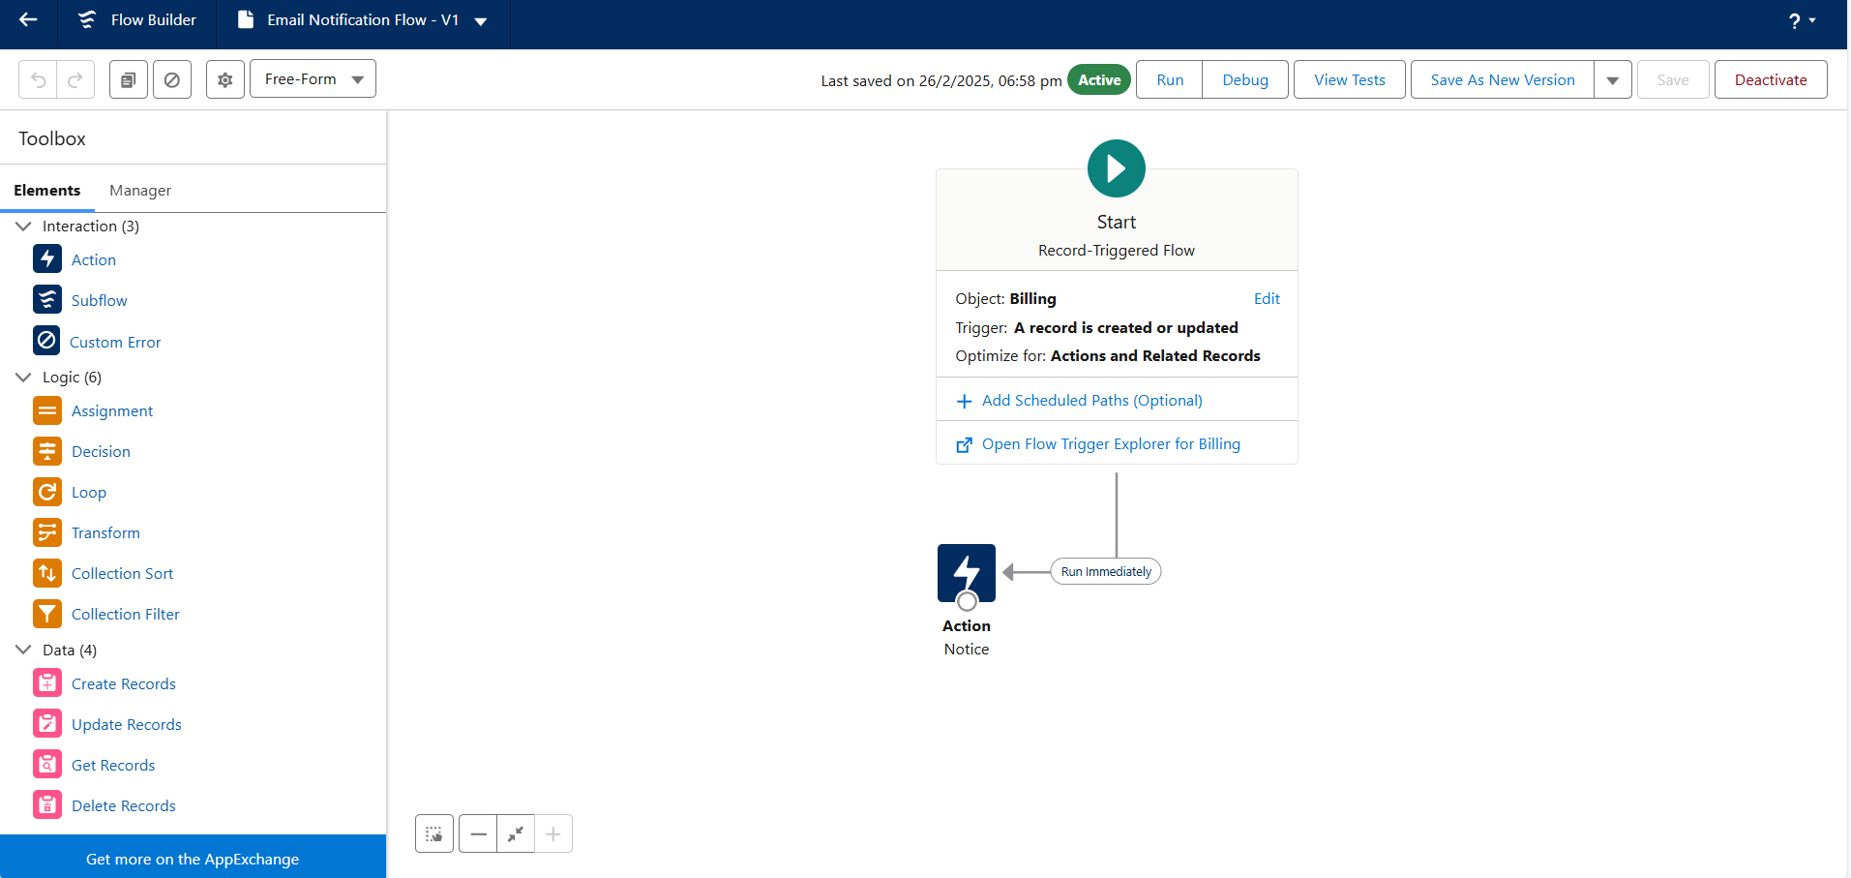
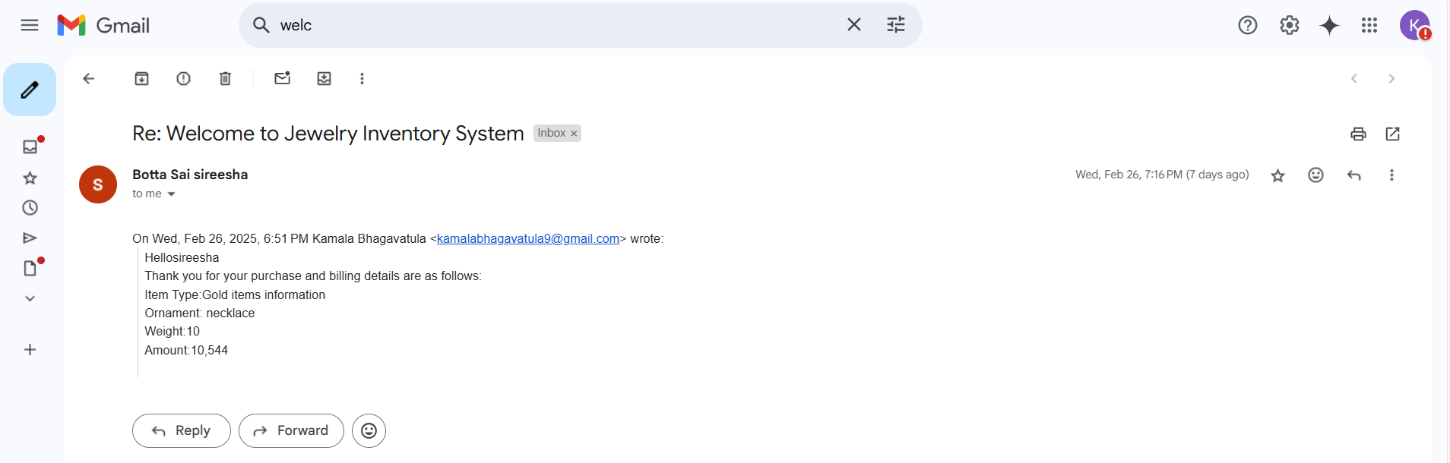
Flows:
Create A Flow:

Slide 27
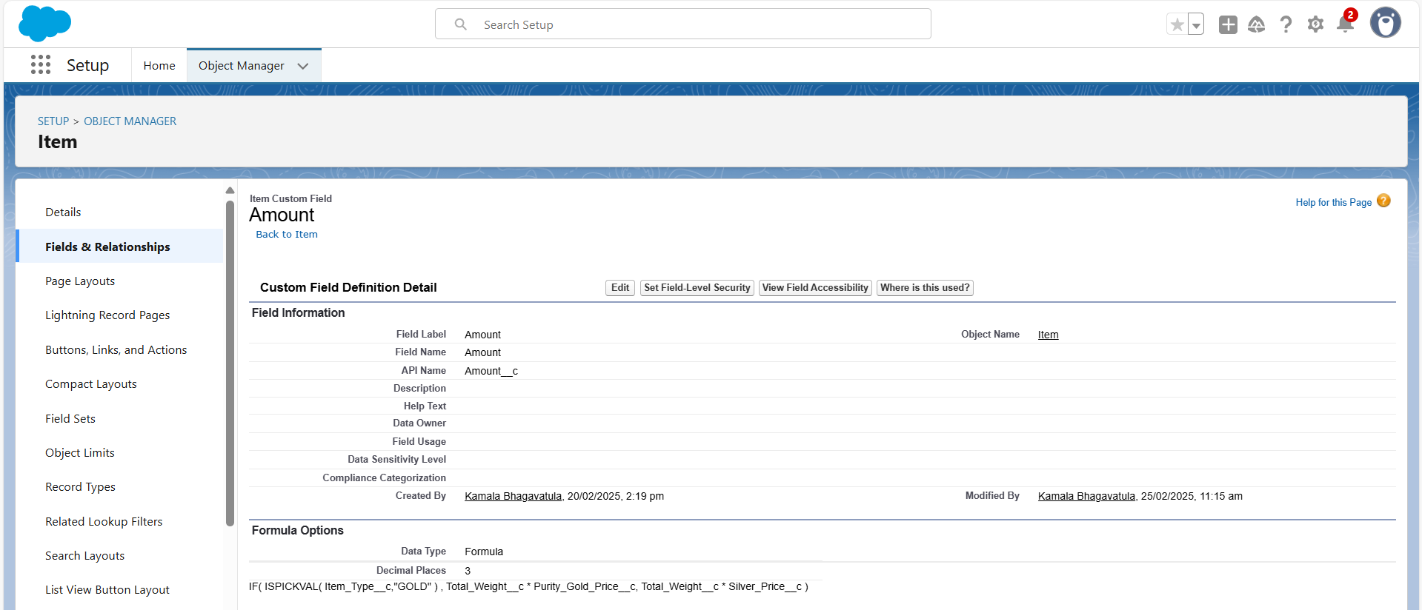
Testing And Validation:
Item:
Field Name: Amount
Data Type: Formula
Formula:
IF(SPICKVAL)Item_type_C,”GOLD”),Total_Weight_c*Purity_Gold_price_c,
Total_Weight_c*Silver_price_c

Slide 28
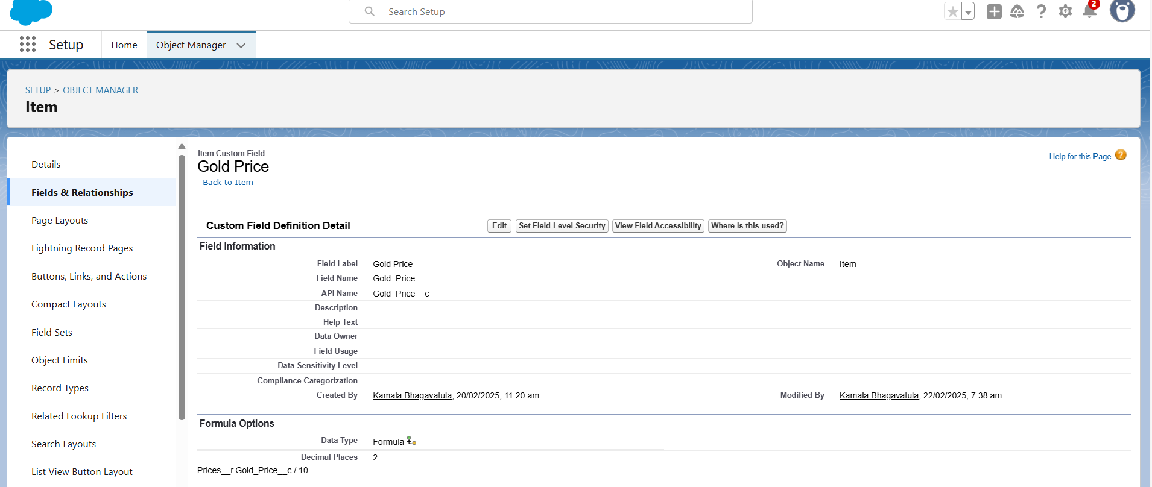
Field Name: Gold/Silver Price
Data Type: Formula
Formula:
IF(SPICKVAL(Item_r.Item_type_C,
”GOLD”),Item_r.Gold_price_c,Item_r.Silver_price_c)

Slide 29
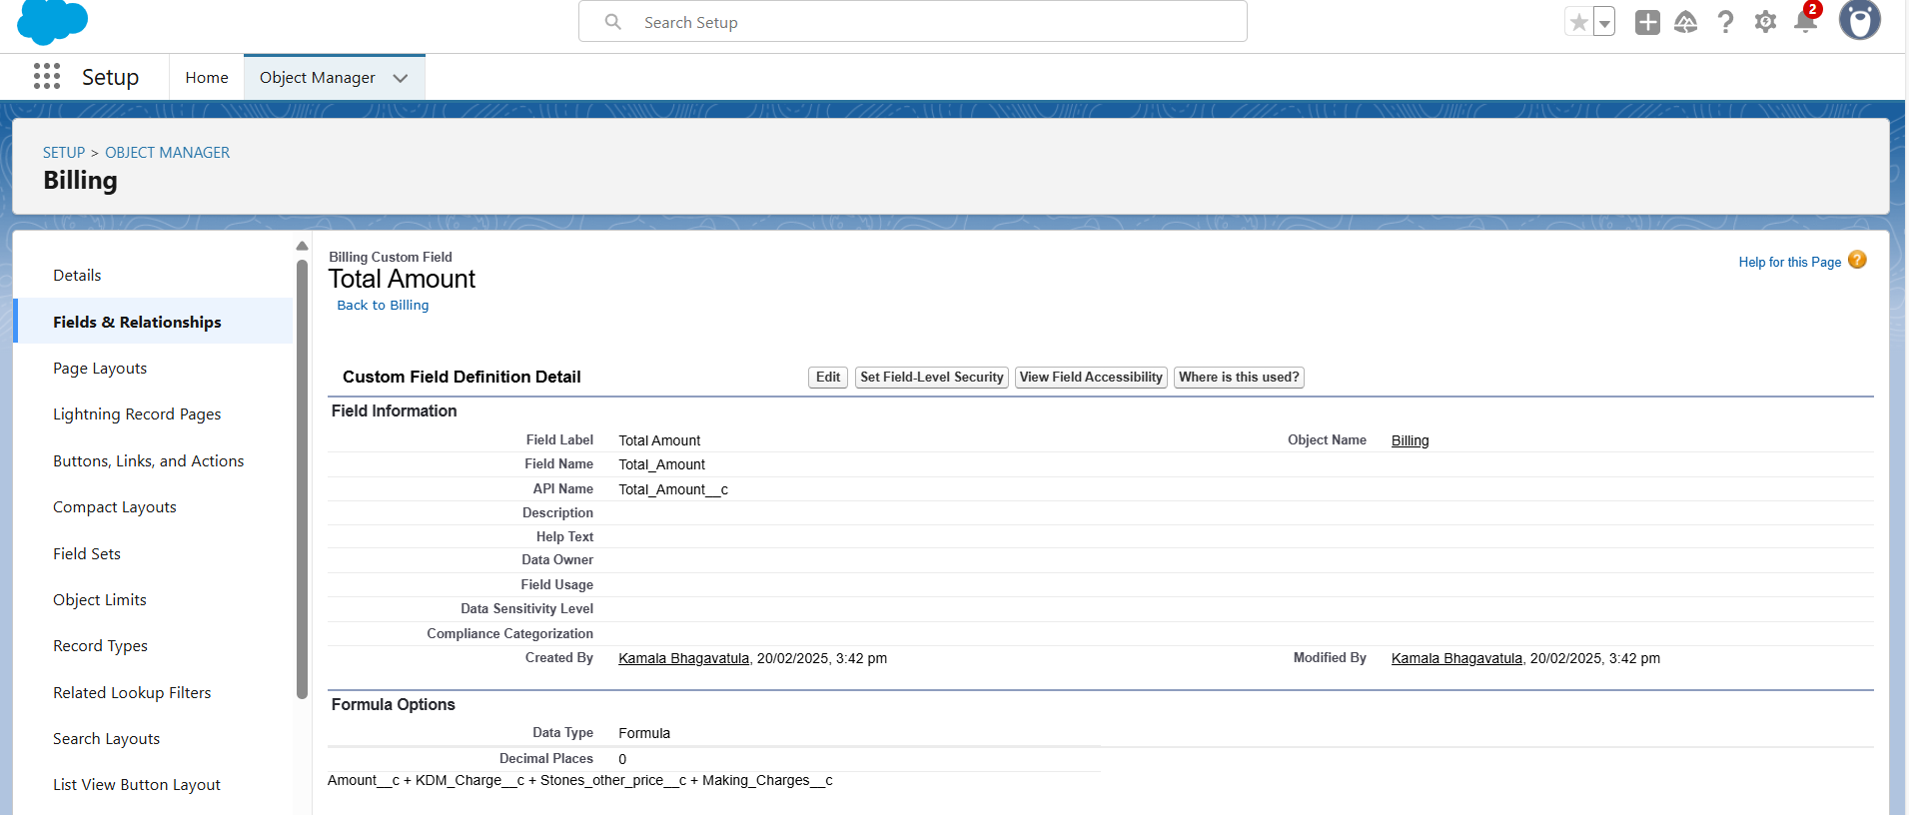
Billing:
Field Name: Total Amont
Data Type: Formula
Formula:
Amount_c+KDM_Charge_C+Stones_Other_price_c+Making_Charges_C

Slide 30
Key scenarios addressed by salesforce in the
Implementation project :
➔ Lead Management: Automate lead assignment, scoring, and routing to ensure timely
follow-up.
➔ Opportunity Management: Streamline opportunity tracking, forecasting, and pipeline
management.
➔ Account Management: Enhance account planning, relationship building, and customer
engagement.
Marketing Scenarios
➔ Campaign Management: Plan, execute, and track marketing campaigns across multiple
channels.
➔ Lead Generation: Automate lead generation, qualification, and nurturing.
➔ Customer Engagement: Personalize customer interactions and measure engagement
metrics.
Service Scenarios
➔ Case Management: Automate case assignment,
routing,and resolution

Slide 31
➔ Customer Support: Provide omnichannel support, including phone, email, chat, and social
media.
➔ Field Service Management*
: Optimize field service operations, including scheduling, routing, and inventory management.
Commerce Scenarios
➔ Order Management: Automate order processing, fulfillment, and shipping.
➔ Customer Experience: Provide personalized, seamless experiences across online and
offline channels.
Analytics Scenarios
➔ Data Integration: Integrate data from multiple sources, including CRM, ERP, and external
data sources.
➔ Data Visualization: Create interactive dashboards and reports to visualize key
performance indicators (KPIs).
➔ Predictive Analytics: Use machine learning and predictive analytics to forecast sales,
customer churn, and other business outcomes.

Slide 32
Conclusion :
In my point of view, the implementation of Salesforce is a complex process
that requires careful planning, execution, and testing. Throughout this project, we
have outlined the key steps involved in implementing Salesforce, including
requirements gathering, solution design, testing and validation, and deployment.
We have also identified key scenarios addressed by Salesforce in the
implementation process, including sales, marketing, service, commerce, analytics,
and integration scenarios.
By following the steps outlined in this project and addressing the key
scenarios, organizations can ensure a successful Salesforce implementation that
meets their business needs and drives user adoption.
THANKYOU SMARTBRIDGE
B.NAGA SAI LAKSHMI KAMALA
TEAM LEADER

